Slide 1
Getting Started with Deep Learning
Seth Juarez
@sethjuarez
Microsoft

Slide 2


Slide 3


Slide 4
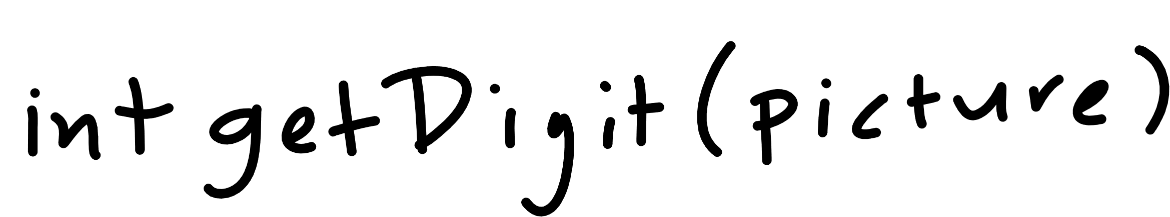

Slide 5
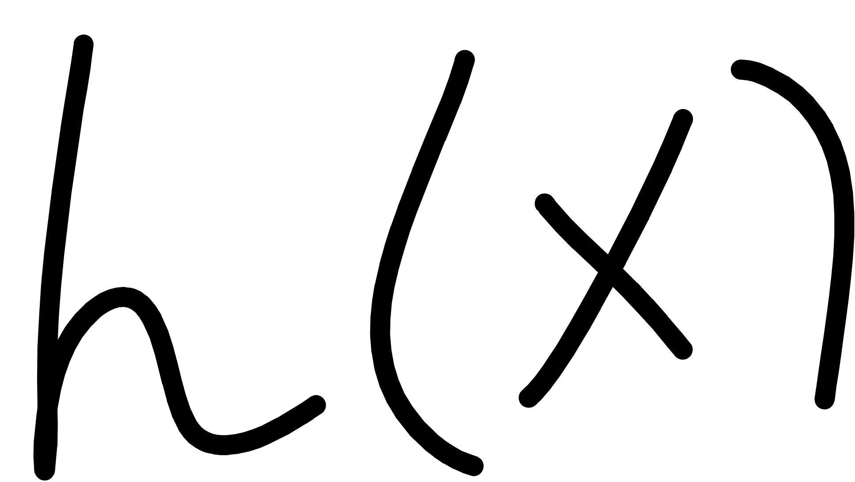
Notes:
Cover the fact that ML uses data to make its own functions

Slide 6
machine learning
how much / how many
which class does this belong to?
are there different groups? which does it belong to?
is this weird?
which option should I choose?

Slide 7
machine learning
(regression) how much / how many
(classification) which class does this belong to?
(clustering) are there different groups? which does it belong to?
(anomaly detection) is this weird?
(recommendation) which option should I choose?
supervised
learning
unsupervised
learning

Slide 8
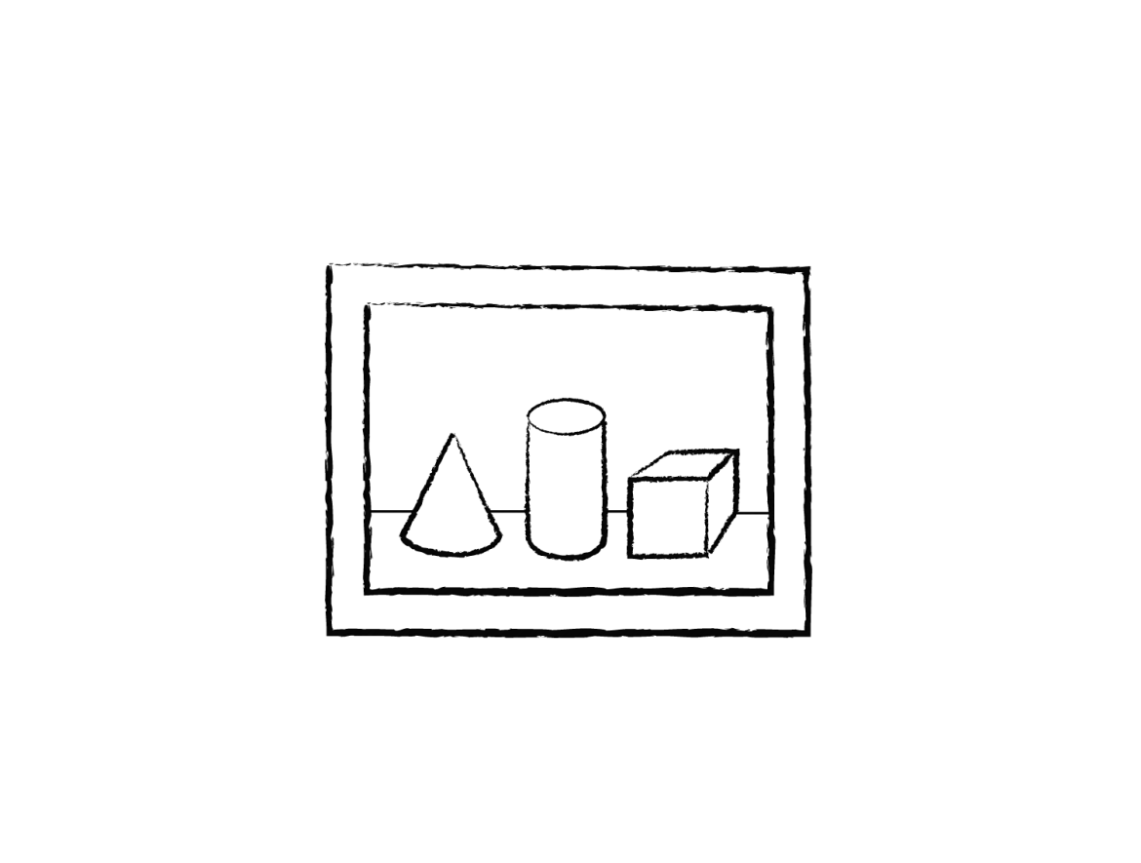
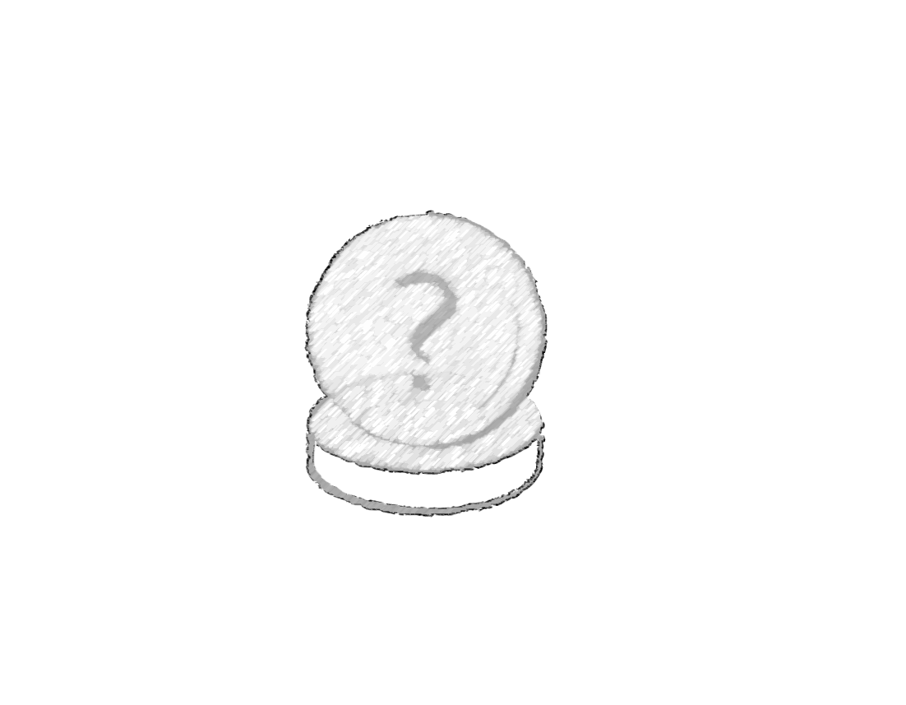
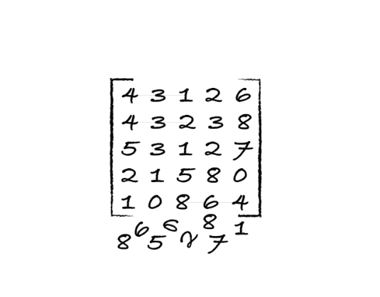
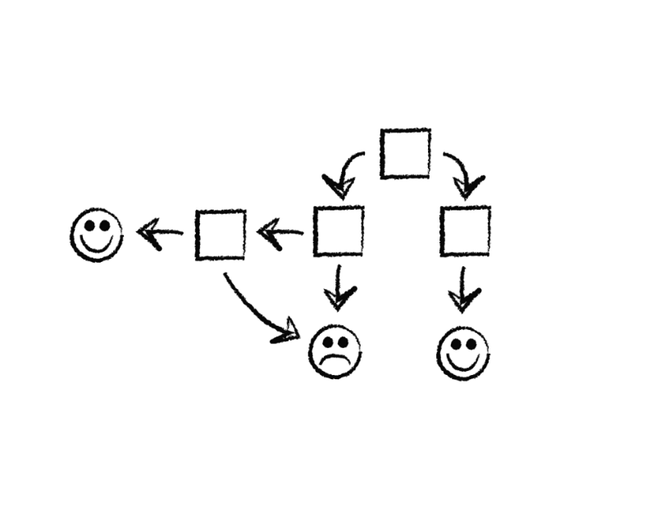
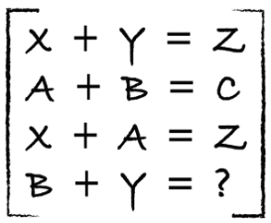
process
identify
predict
1
4
explore
analyze
encode
model
2
3

Slide 9
identify data
Class | Outlook | Temp. | Windy
Play | Sunny | Low | Yes
No Play | Sunny | High | Yes
No Play | Sunny | High | No
Play | Overcast | Low | Yes
Play | Overcast | High | No
Play | Overcast | Low | No
No Play | Rainy | Low | Yes
Play | Rainy | Low | No
? | Sunny | Low | No
label (y)
play / no play
features
outlook, temp, windy
values (x)
[Sunny, Low, Yes]

Slide 10
explore / analyze / clean
Class | Outlook | Temp. | Windy
Play | Sunny | Lowest | Yes
No Play | ? | High | Yes
No Play | Sunny | High | KindOf
Play | Overcast | Low | Yes
Play | Turtle Cloud | High | No
Play | Overcast | ? | No
No Play | Rainy | Low | 28%
Play | Rainy | Low | No
? | Sunny | Low | No
yak shaving
Any apparently useless activity which, by allowing you to overcome intermediate difficulties, allows you to solve a larger problem.
I was doing a bit of yak shaving this morning, and it looks like it might have paid off.
wikipedia

Slide 11
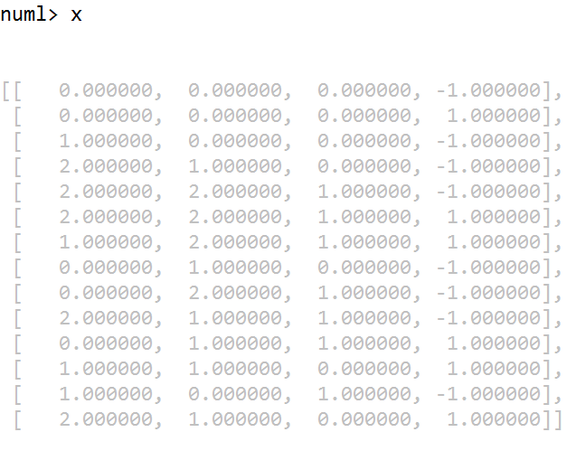
explore / analyze / clean
Class | Outlook | Temp. | Windy
Play | Sunny | Low | Yes
No Play | Sunny | High | Yes
No Play | Sunny | High | No
Play | Overcast | Low | Yes
Play | Overcast | High | No
Play | Overcast | Low | No
No Play | Rainy | Low | Yes
Play | Rainy | Low | No
? | Sunny | Low | No

Slide 12
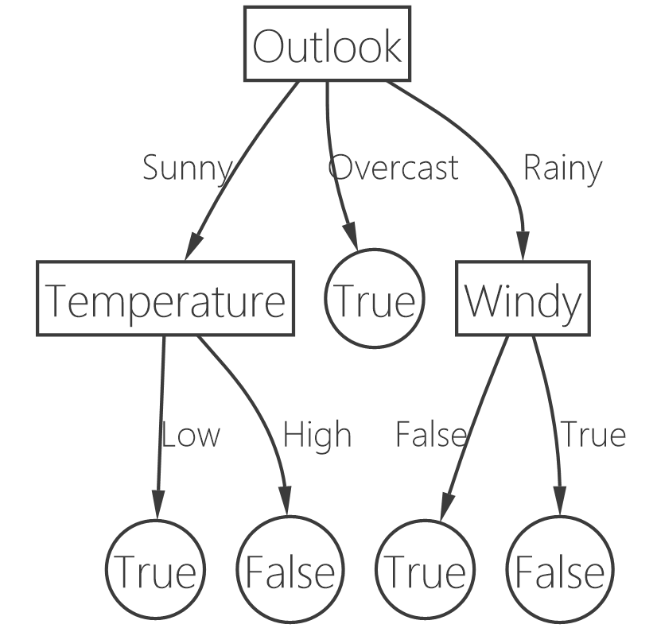
model
Class | Outlook | Temp. | Windy
Play | Sunny | Low | Yes
No Play | Sunny | High | Yes
No Play | Sunny | High | No
Play | Overcast | Low | Yes
Play | Overcast | High | No
Play | Overcast | Low | No
No Play | Rainy | Low | Yes
Play | Rainy | Low | No
? | Sunny | Low | No

Slide 13
predict
Class | Outlook | Temp. | Windy
? | Sunny | Low | No
PLAY!!!

Slide 14
how well is it doing?
Train
Test
Use ~80%
Use ~20%

Slide 15
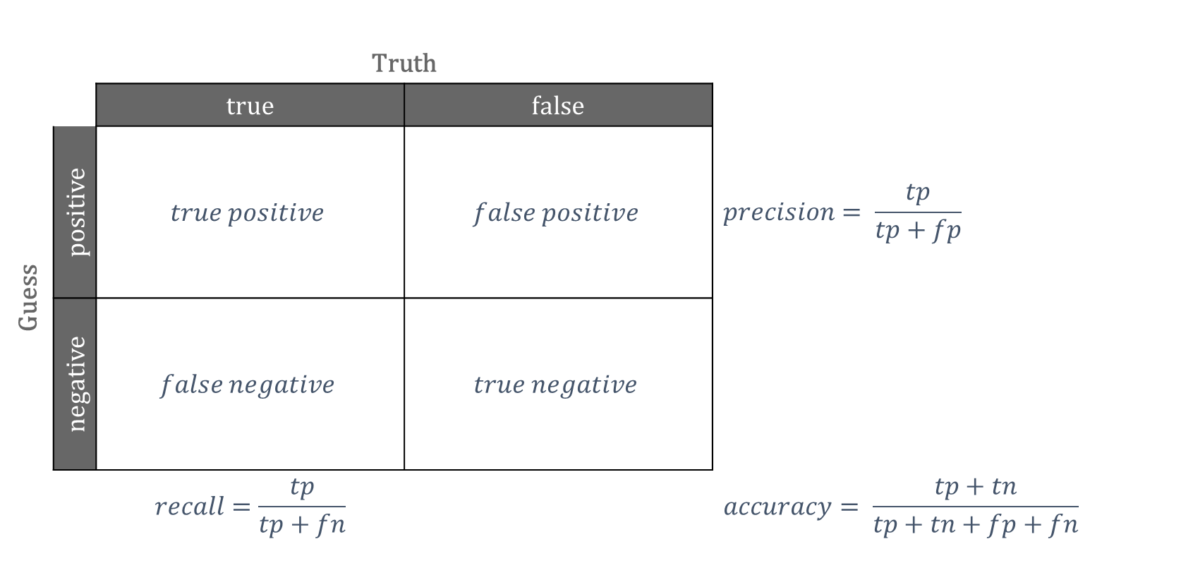
confusion matrix
 |  | Truth
 |  | true | false
Guess | positive | $$true positive$$ | $$false positive$$ | $$precision= \frac{tp}{tp+fp}$$
 | negative | $$false negative$$ | $$true negative$$
 |  | $$recall=\frac{tp}{tp+fn}$$ |  | $$accuracy= \frac{tp+tn}{tp+tn+fp+fn}$$

Slide 16
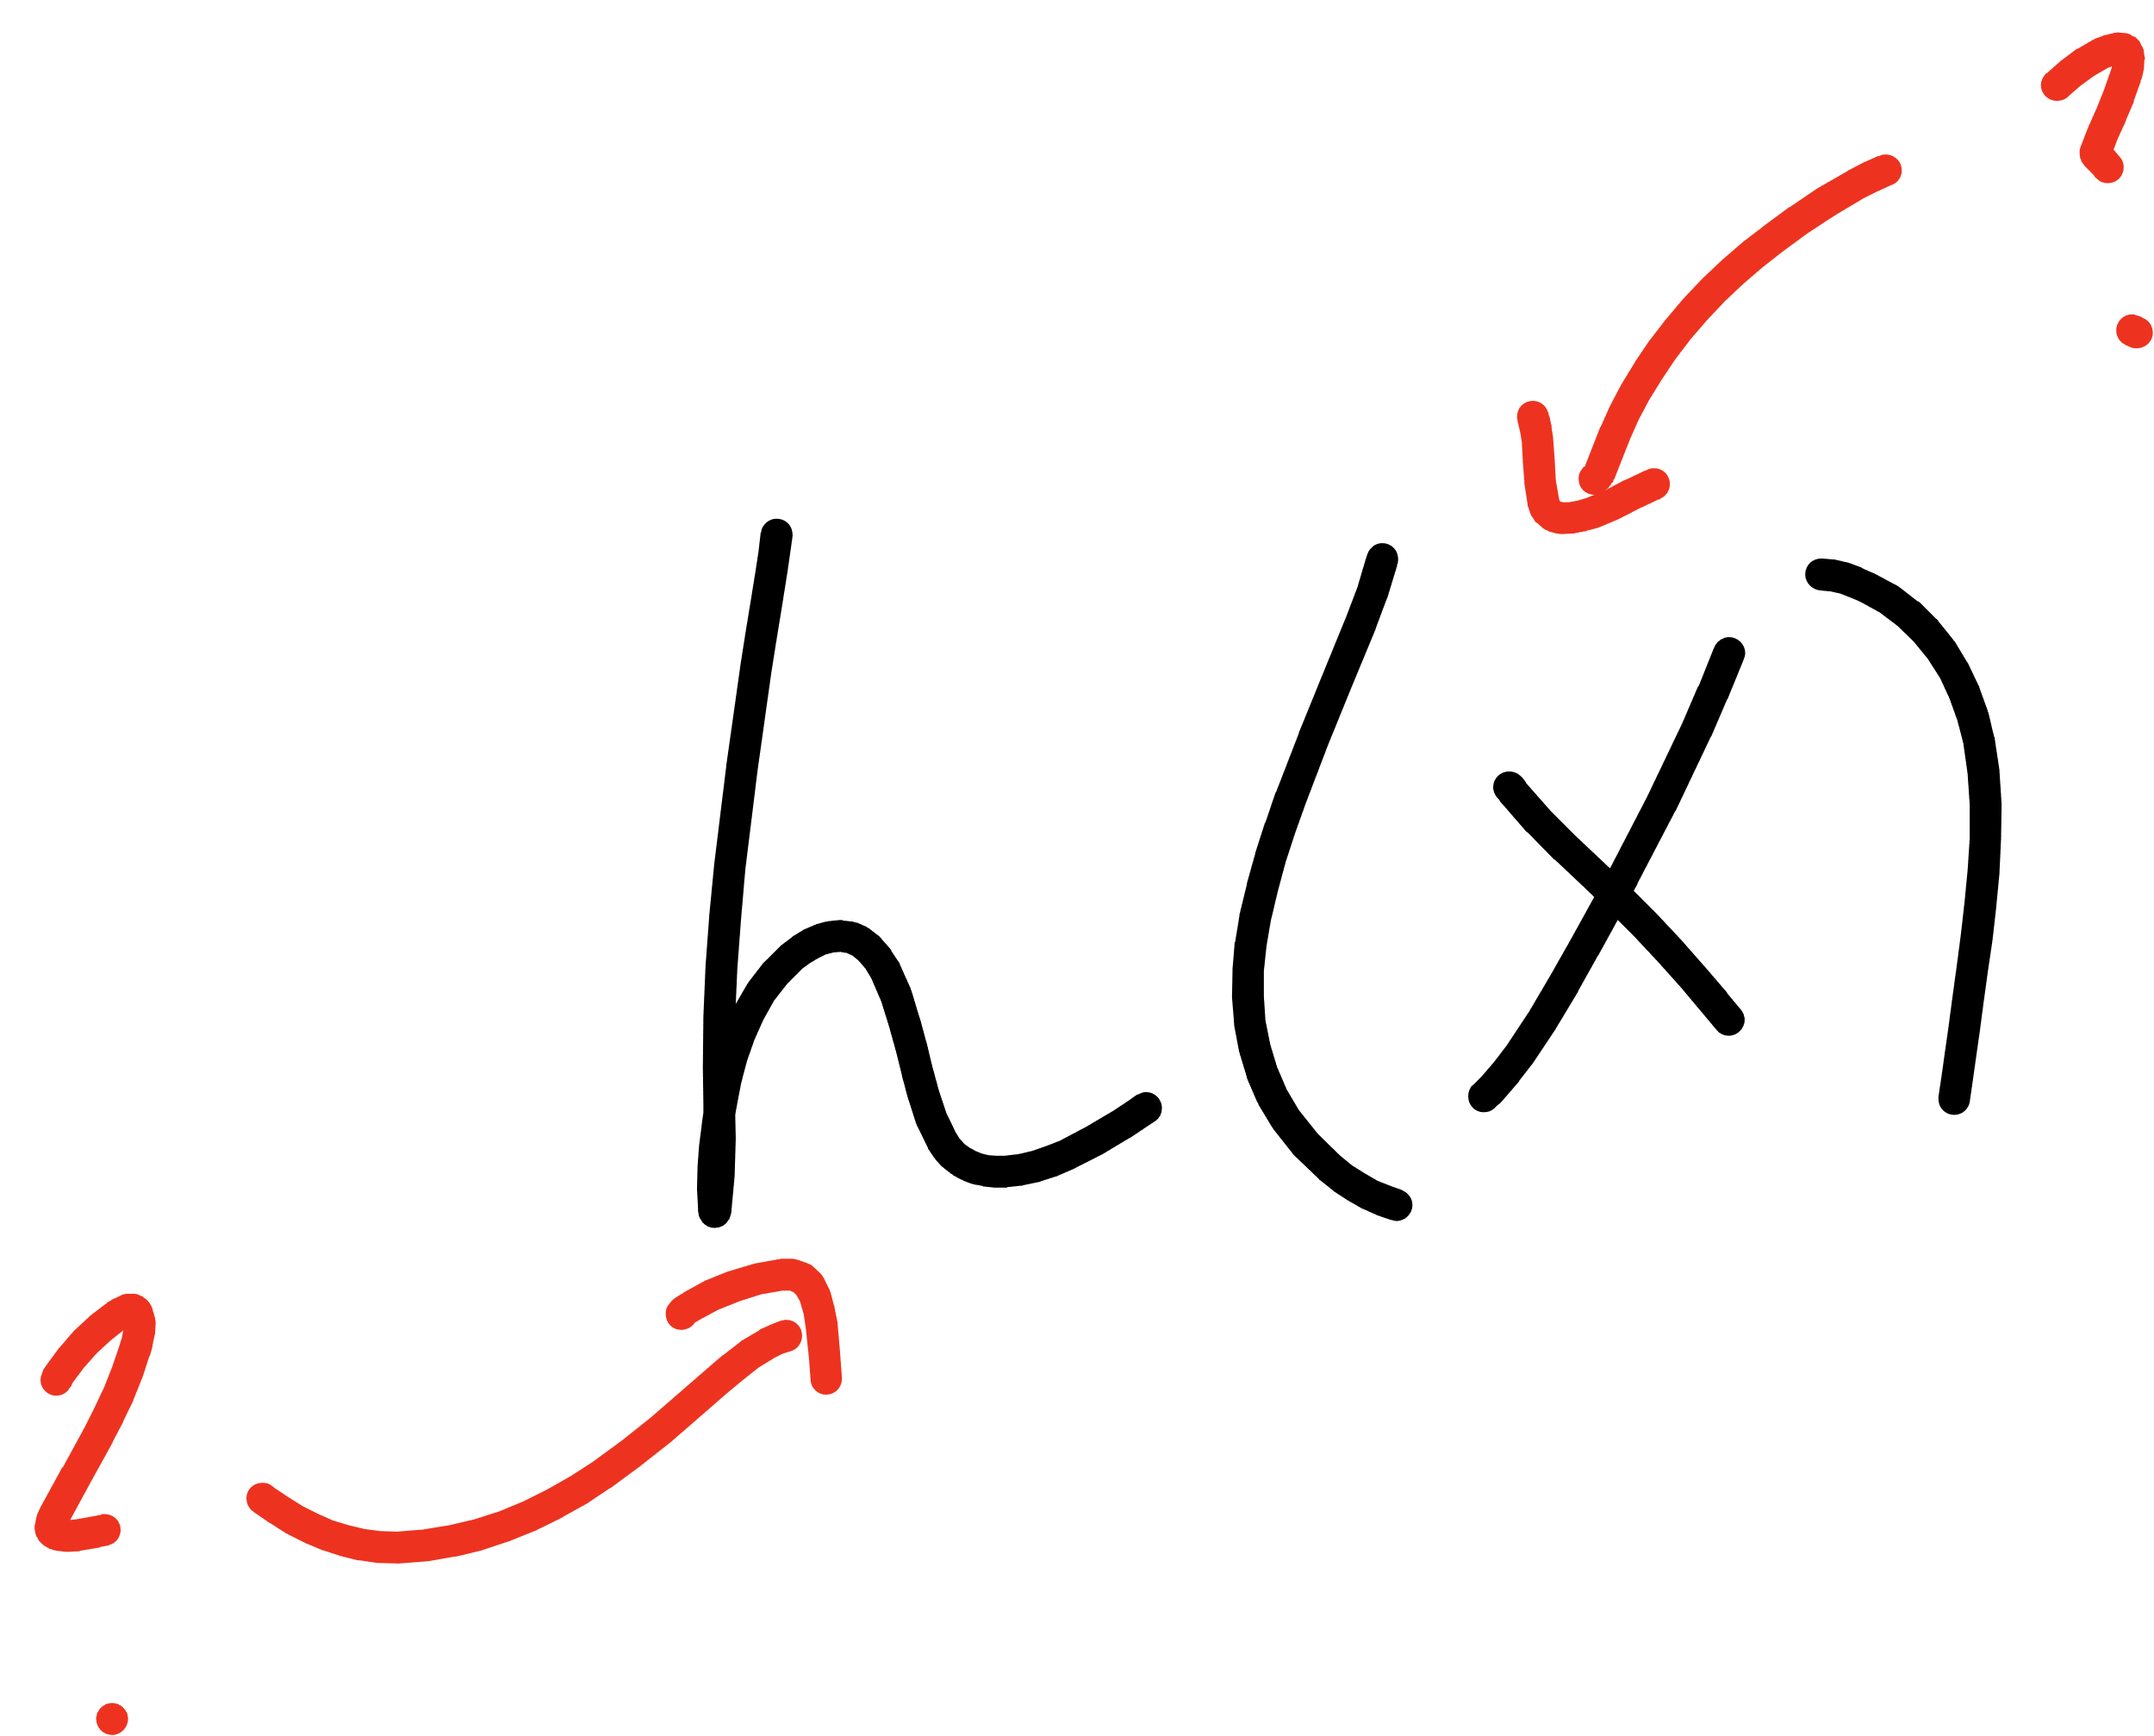
Notes:
Open mnist data representation

Slide 17
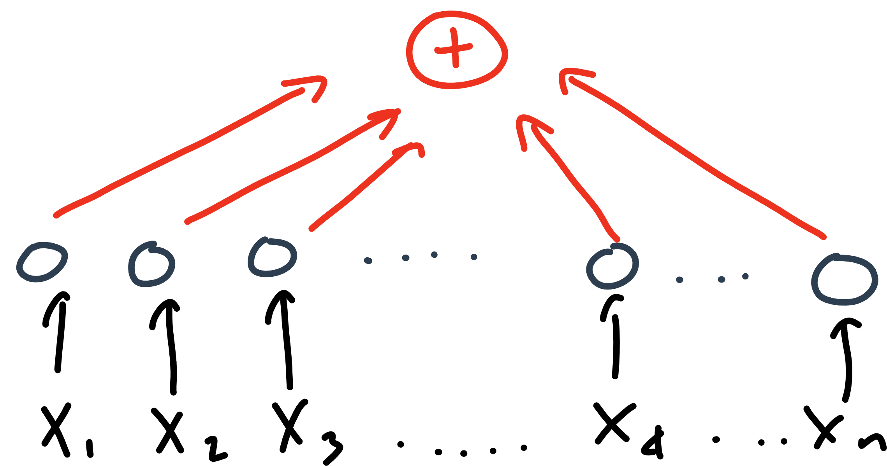

Slide 18
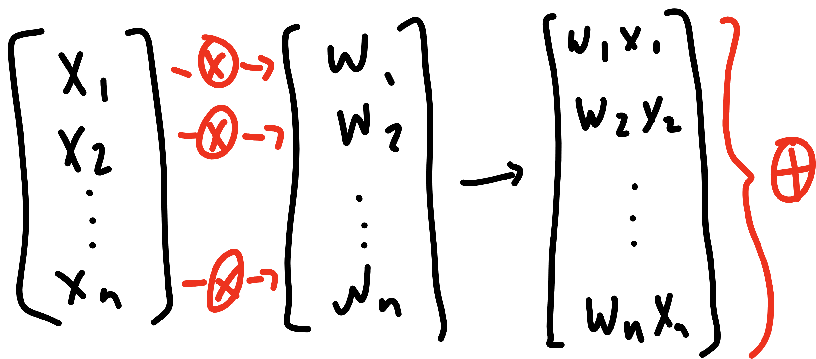

Slide 19
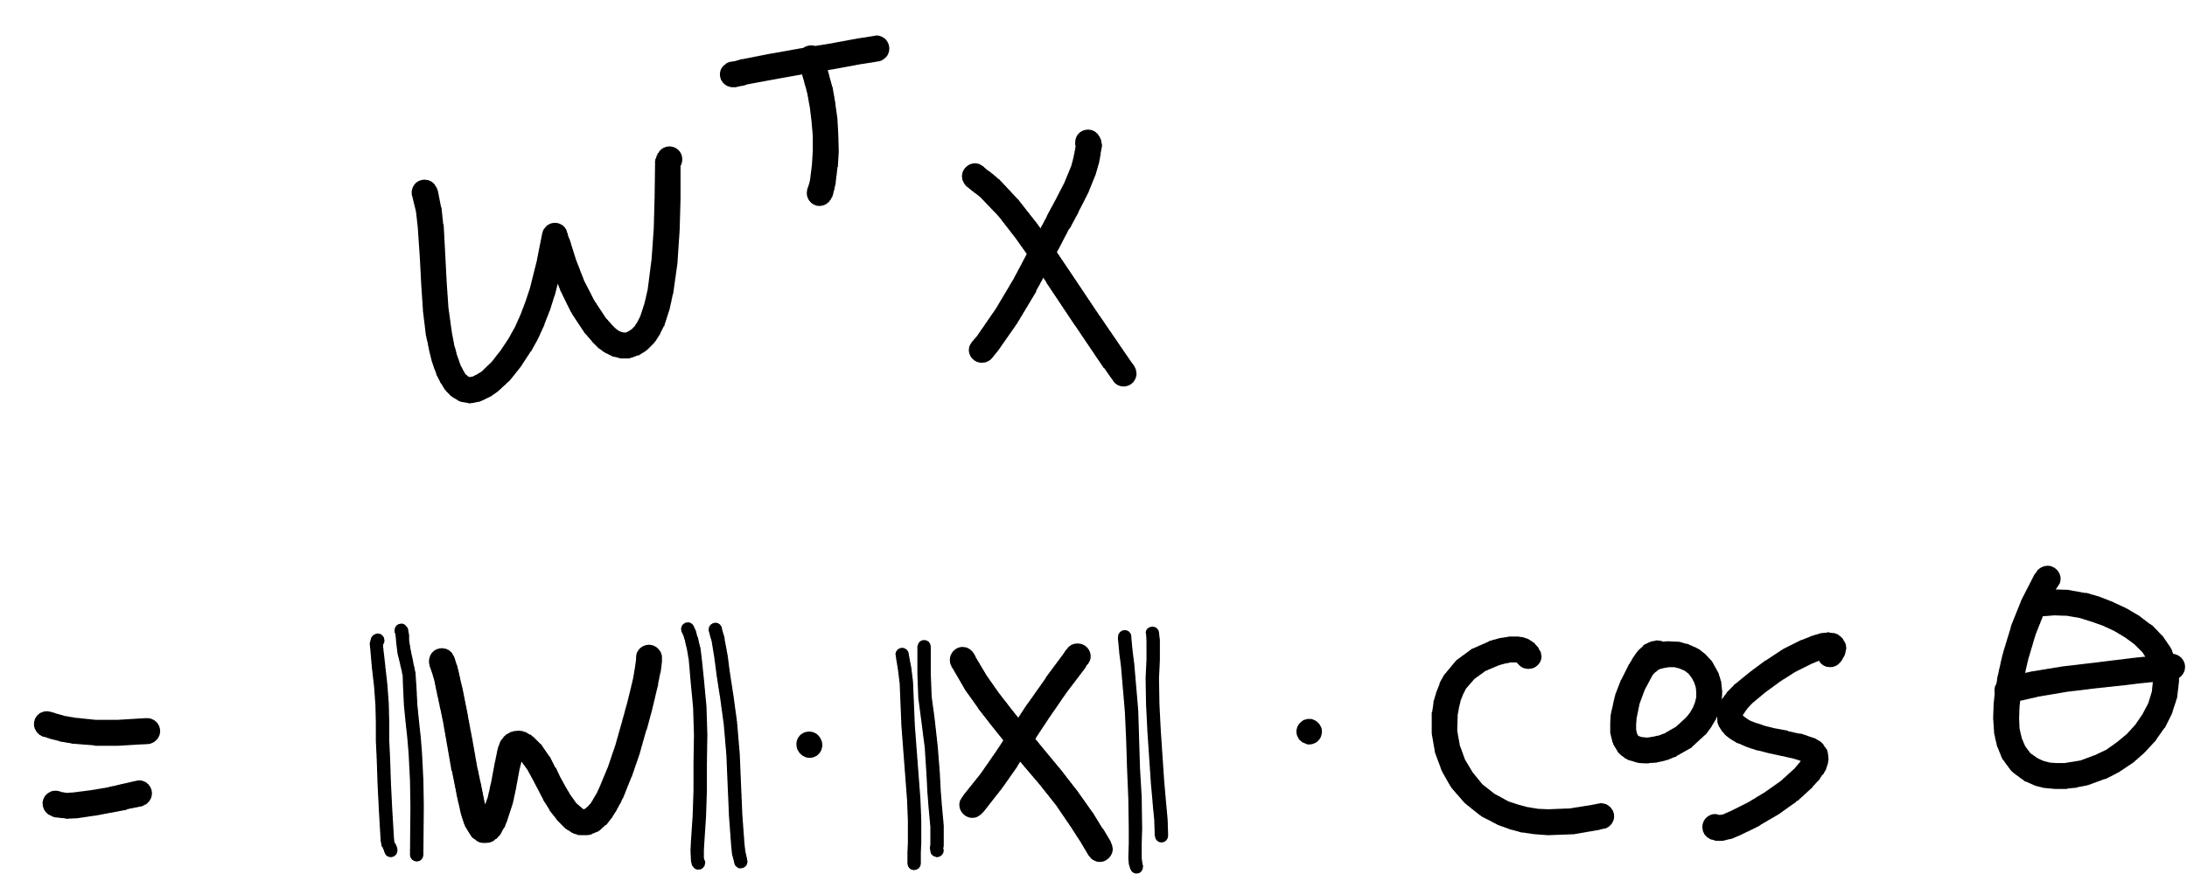

Slide 20
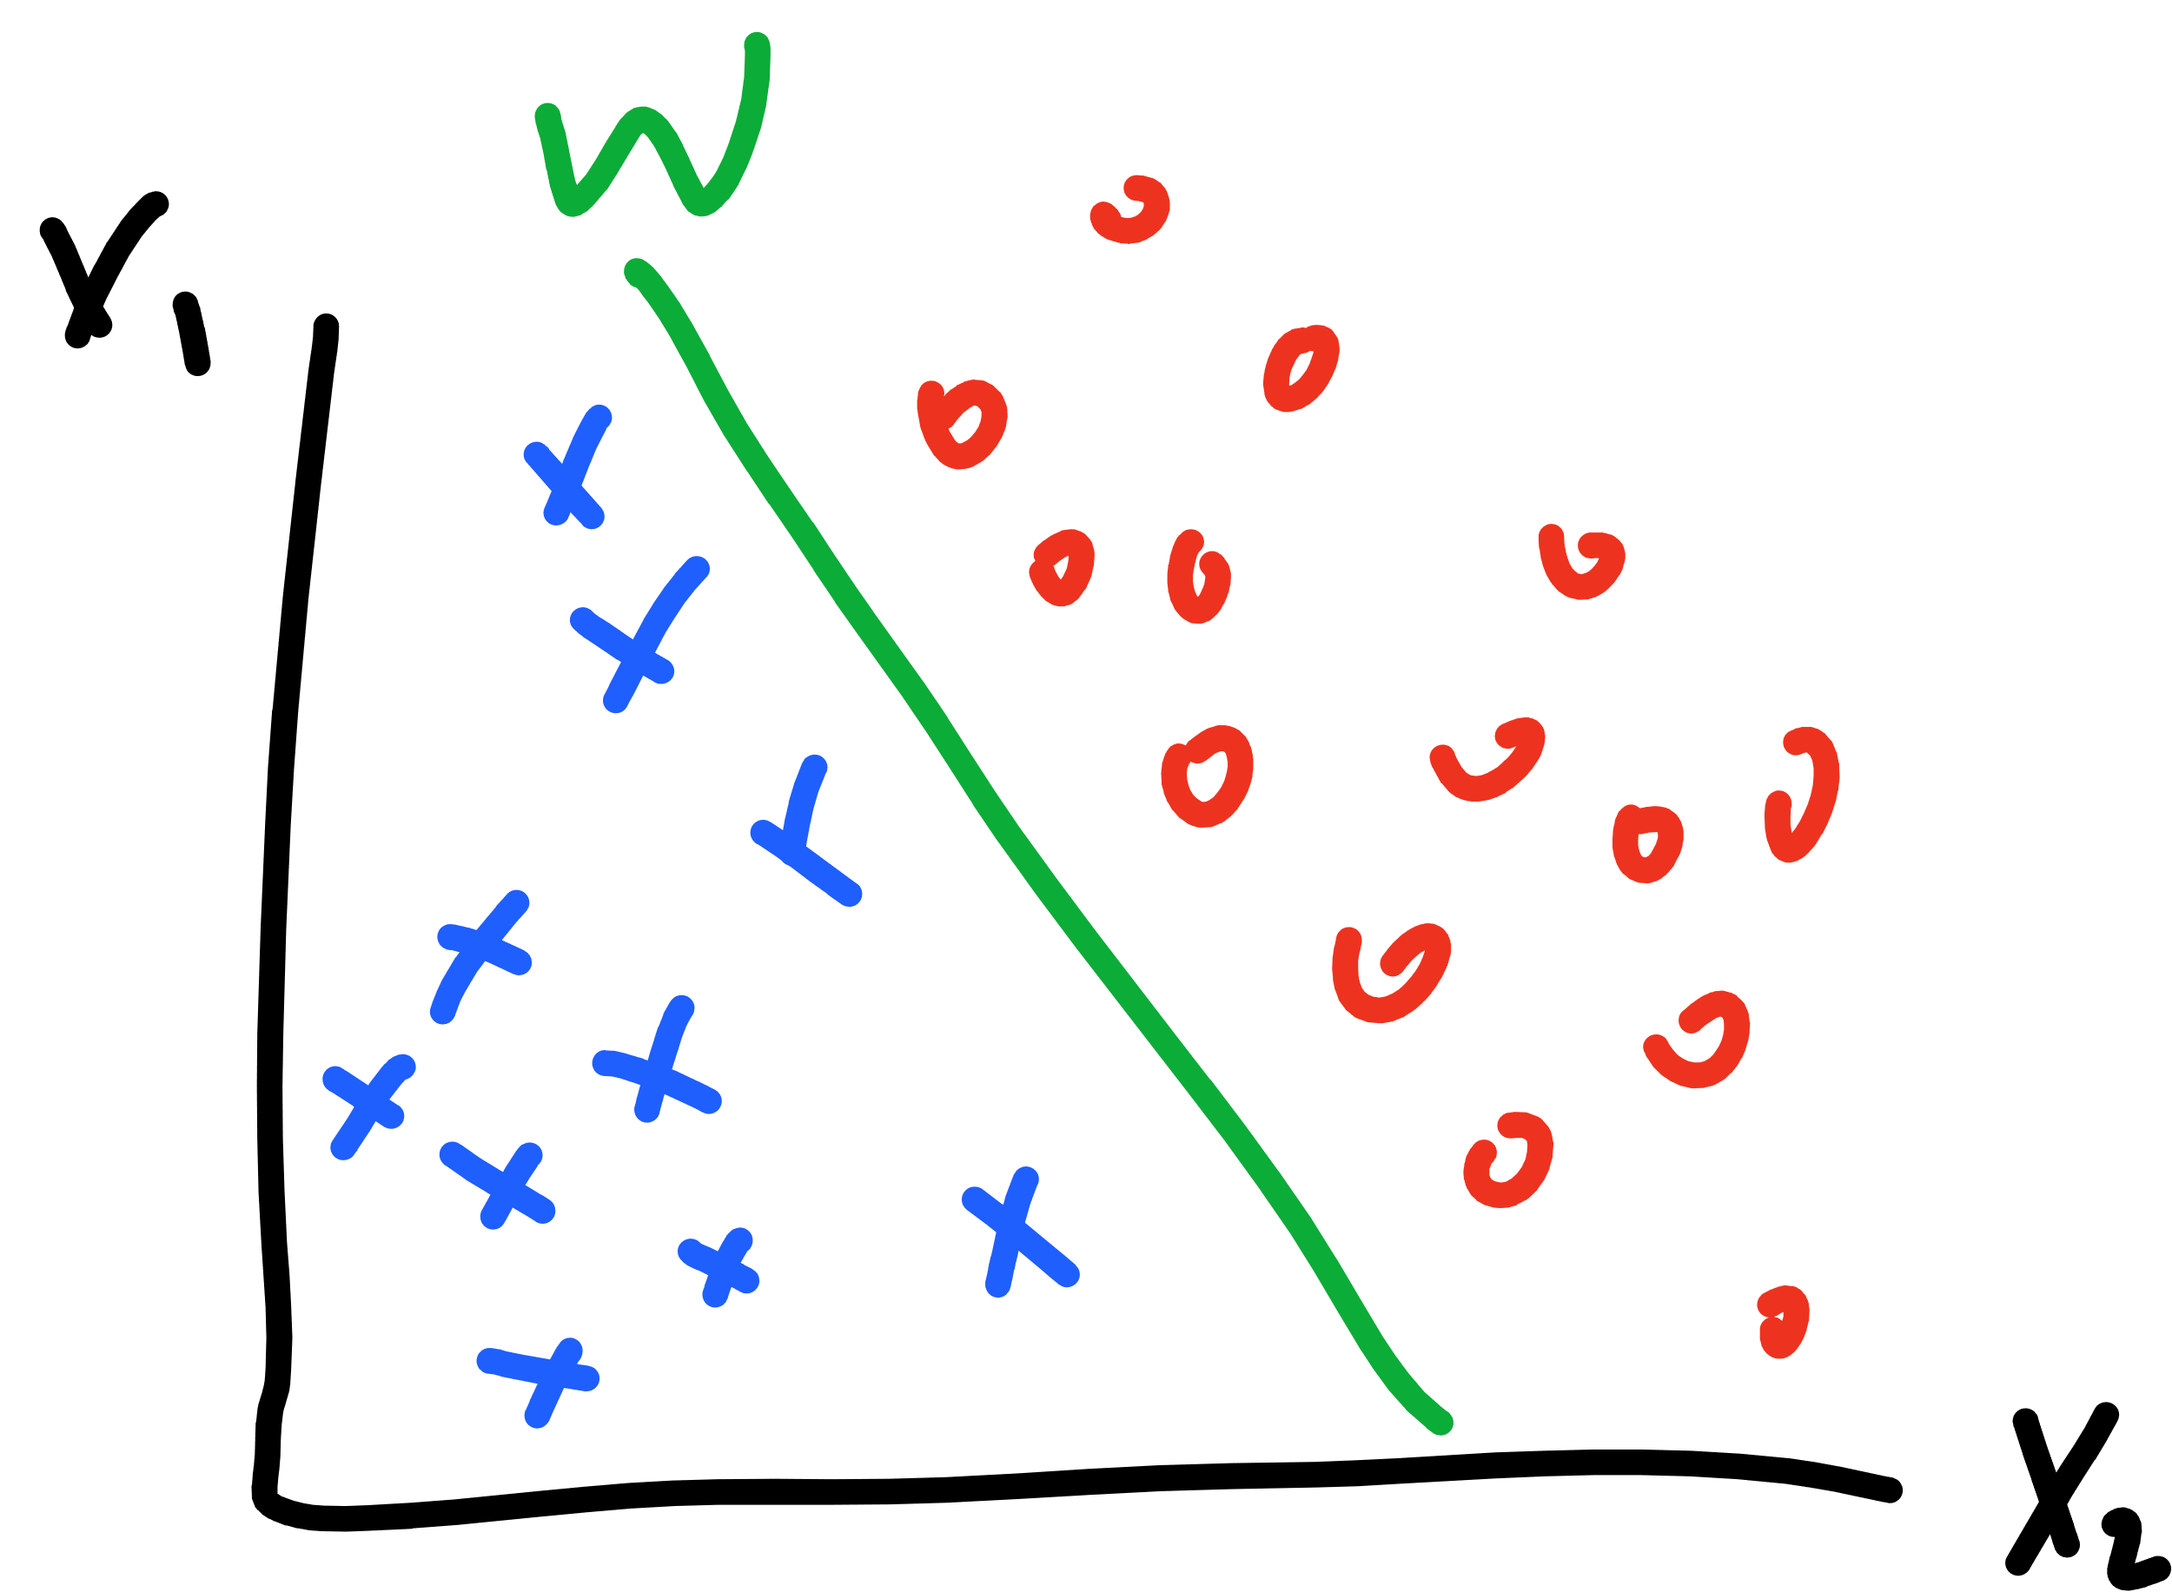

Slide 21
Notes:
Single output
What about one-hot encoded?

Slide 22
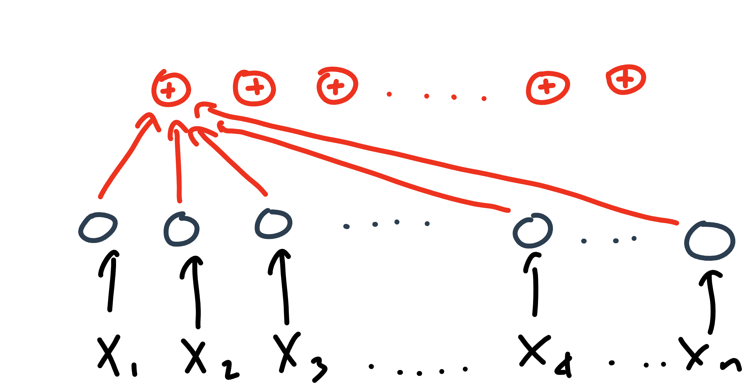

Slide 23
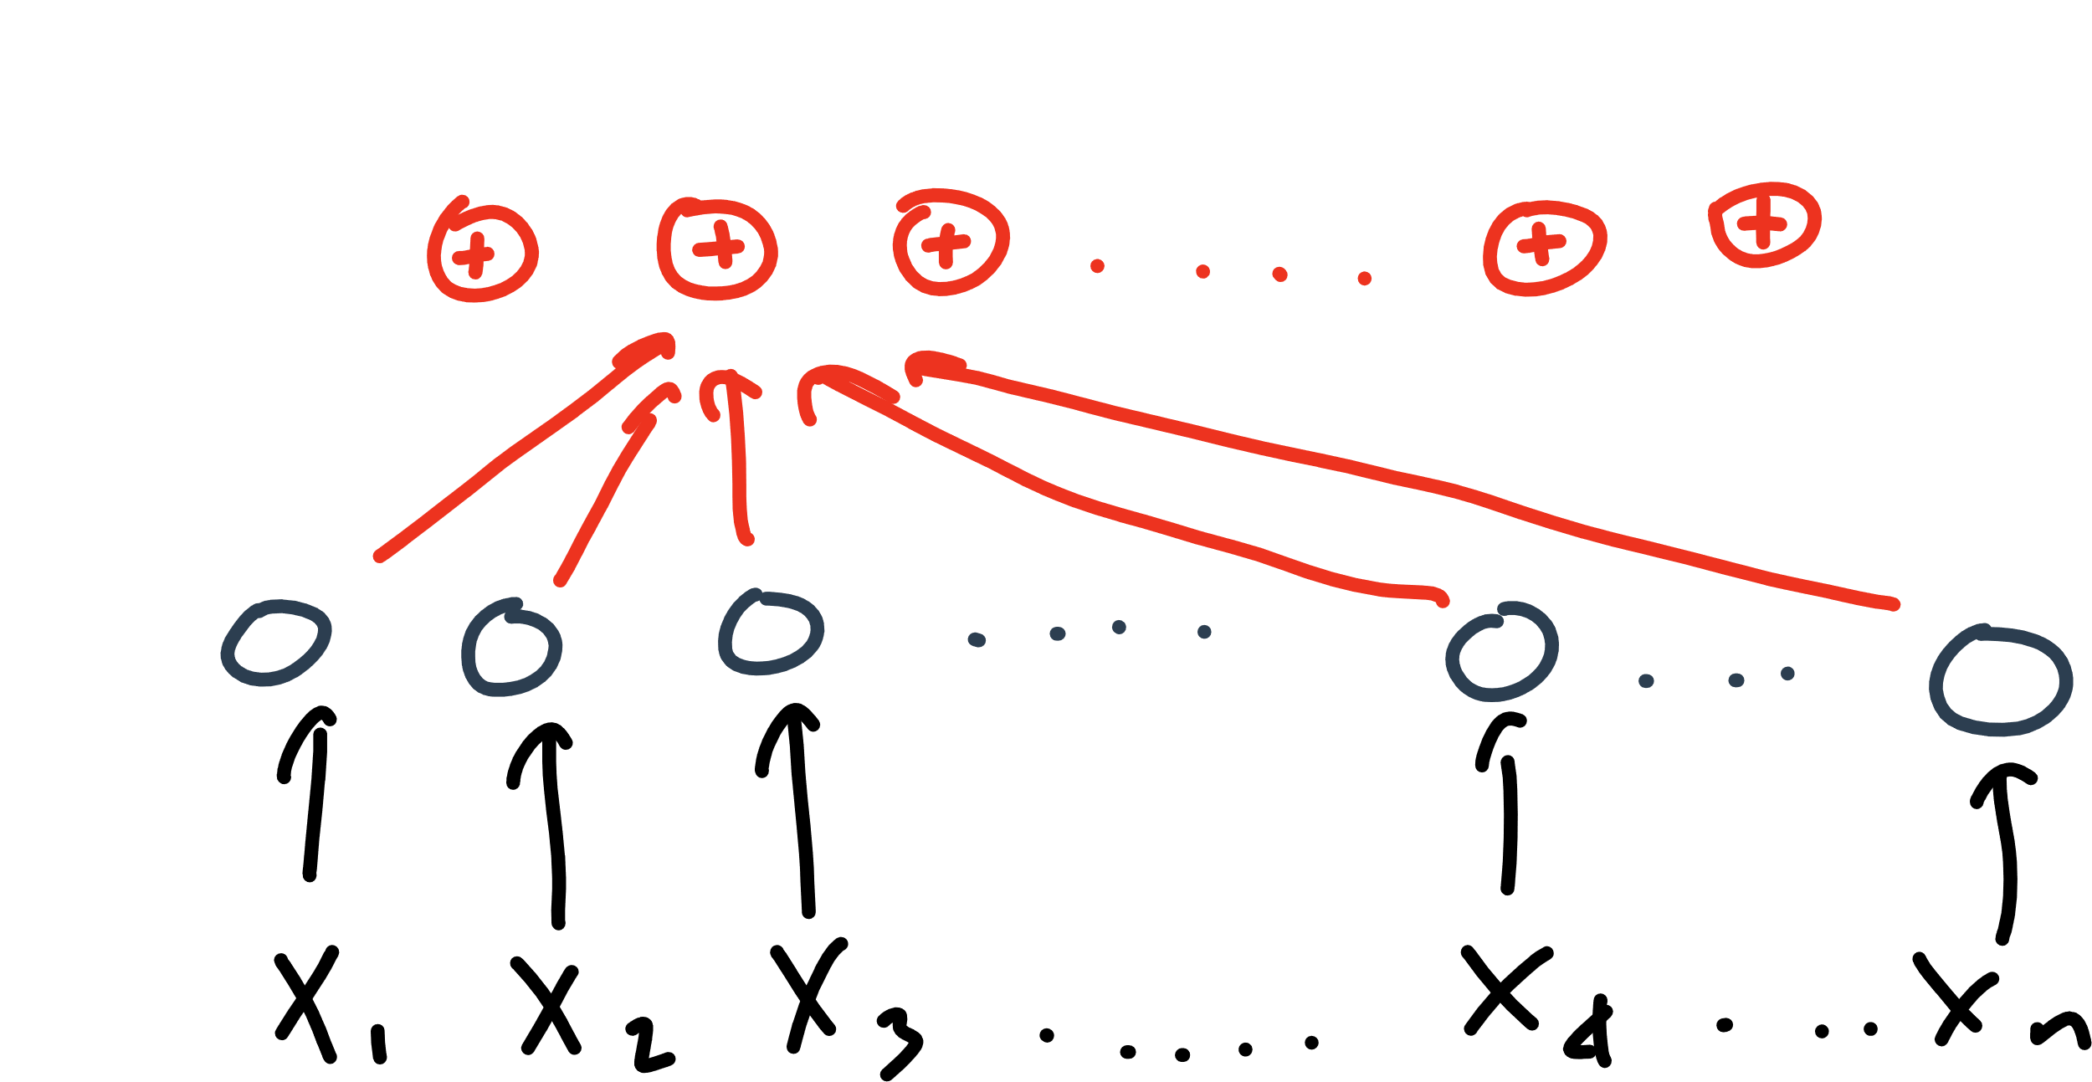

Slide 24
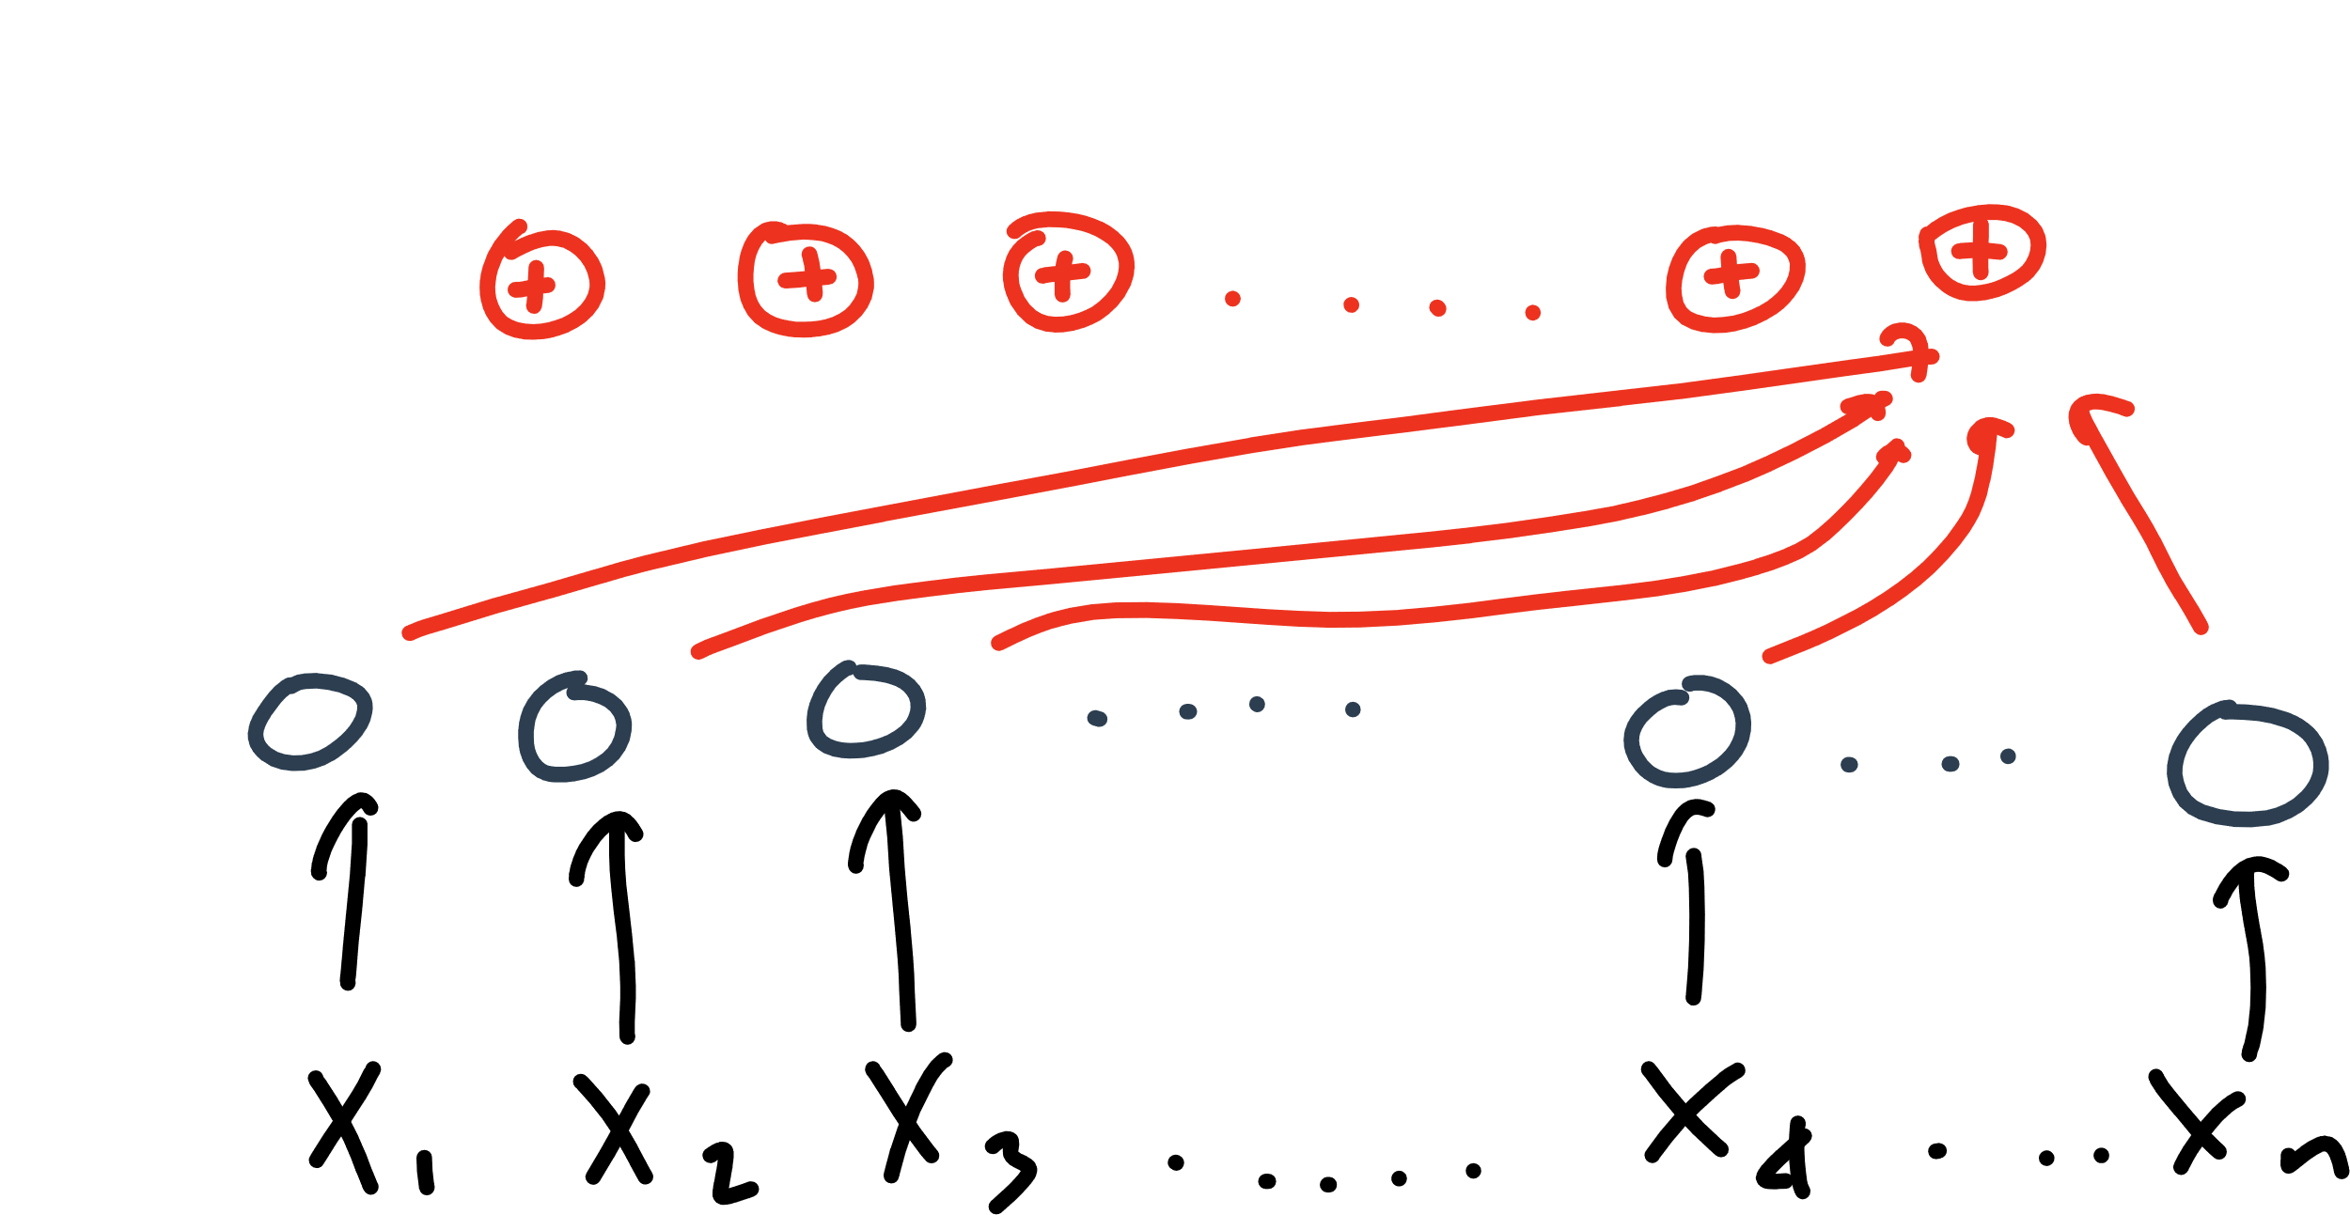

Slide 25
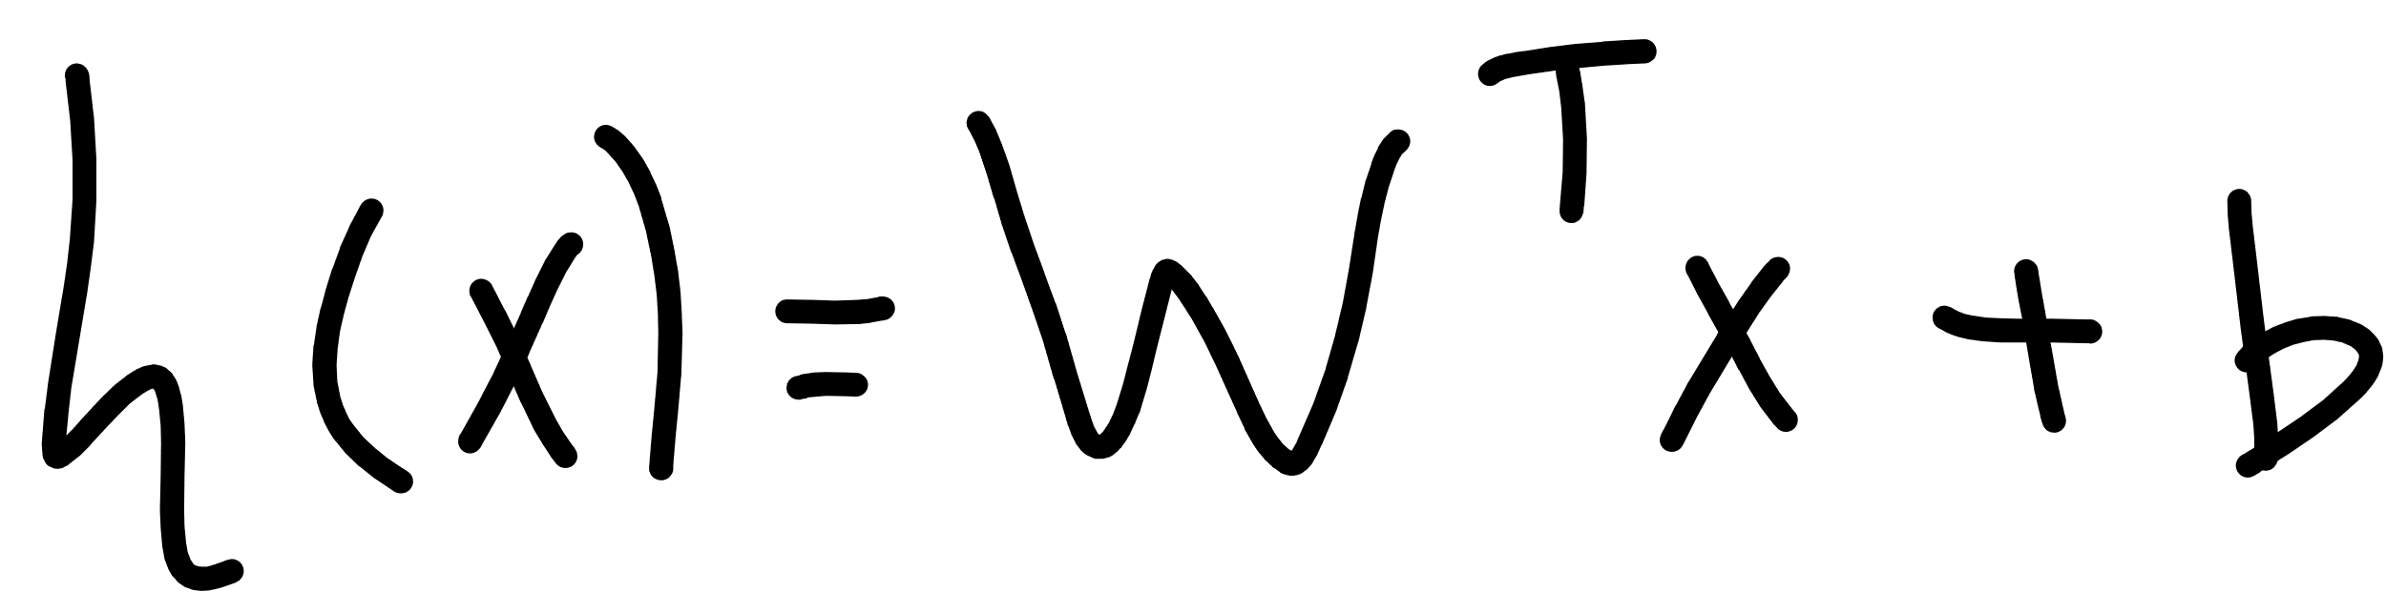

Slide 26
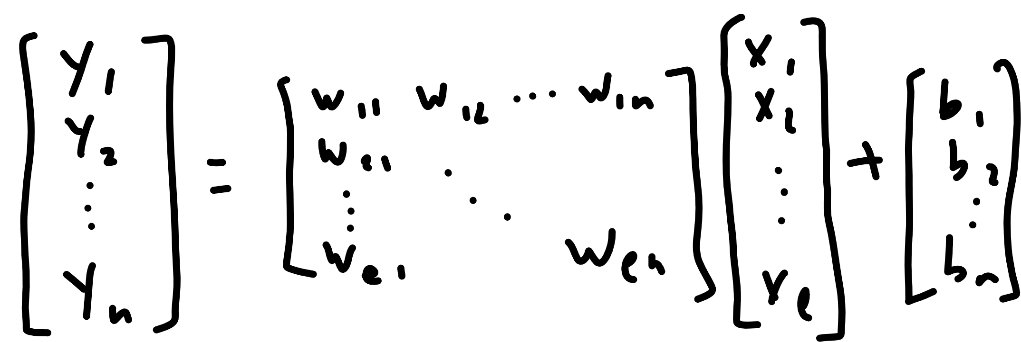

Slide 27


Slide 28
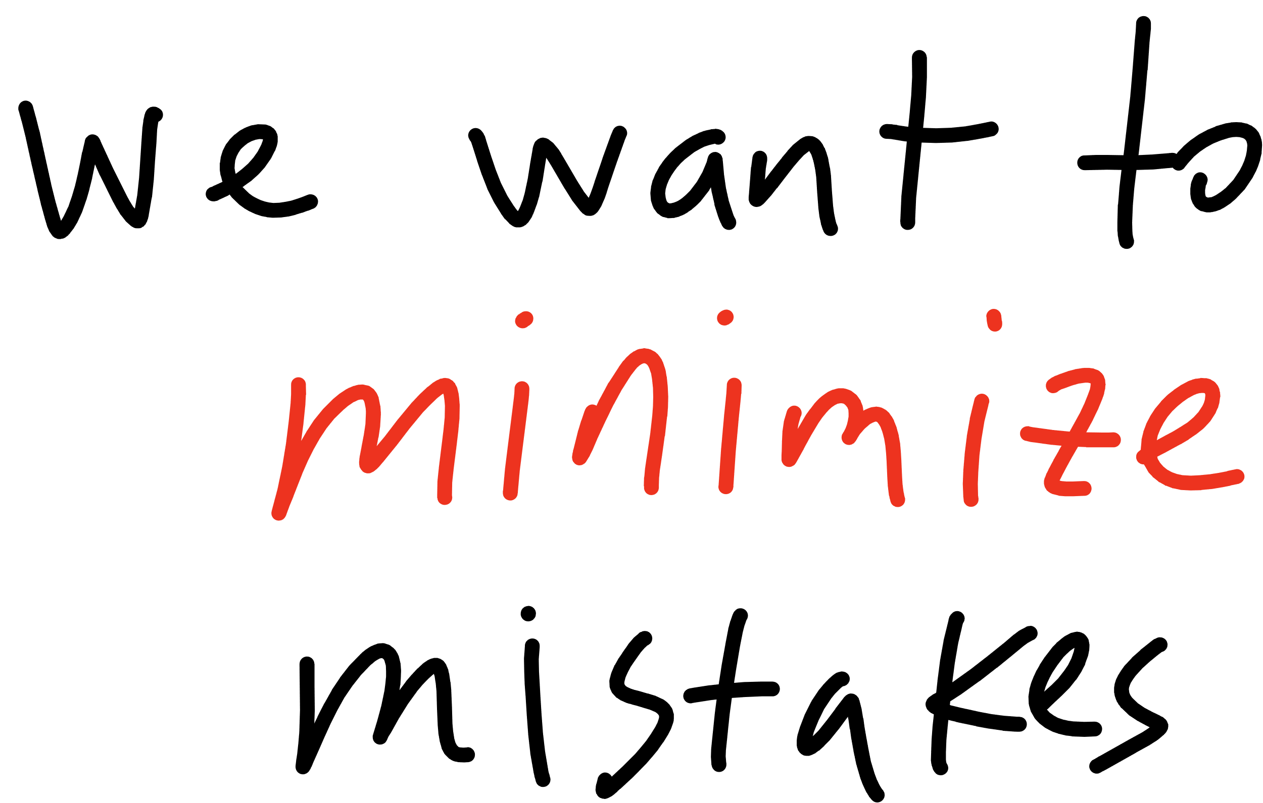

Slide 29
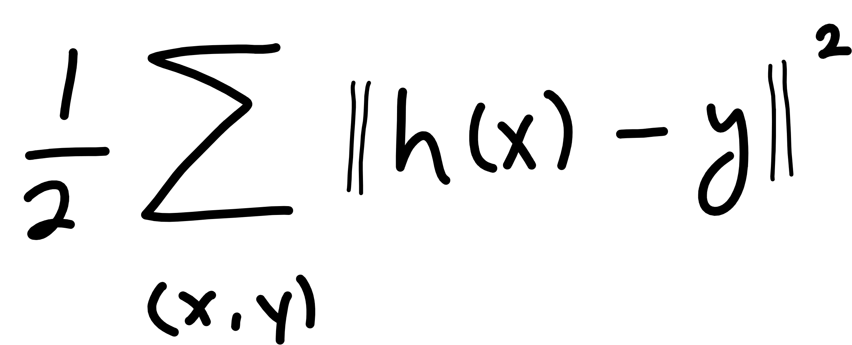
Notes:
Cost function
(WHERE IS W???)

Slide 30
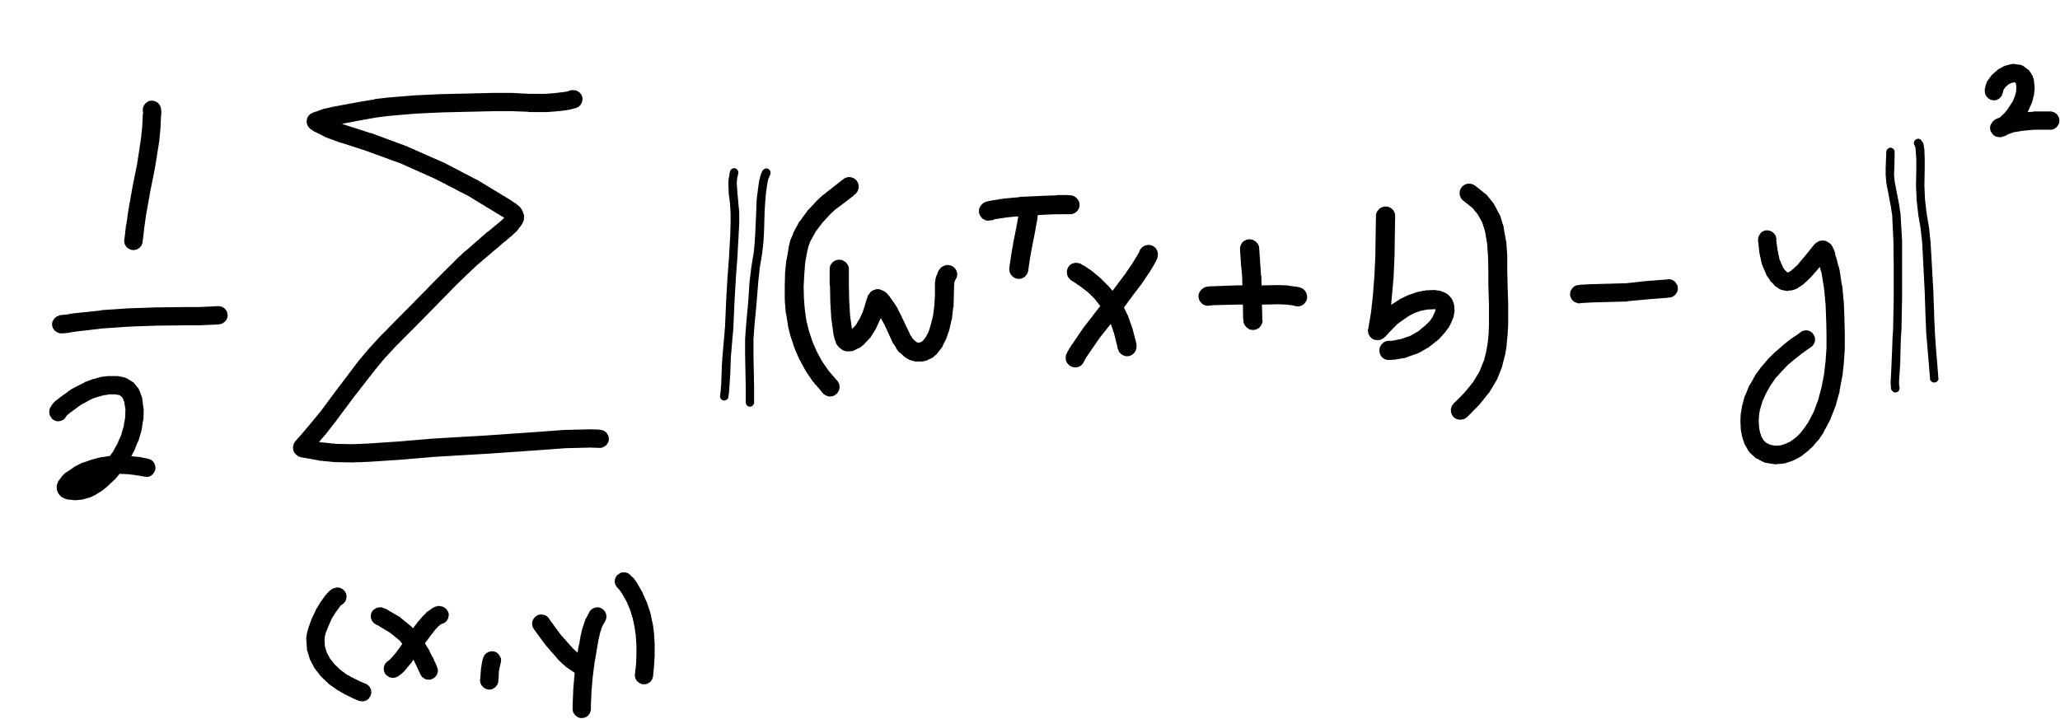

Slide 31
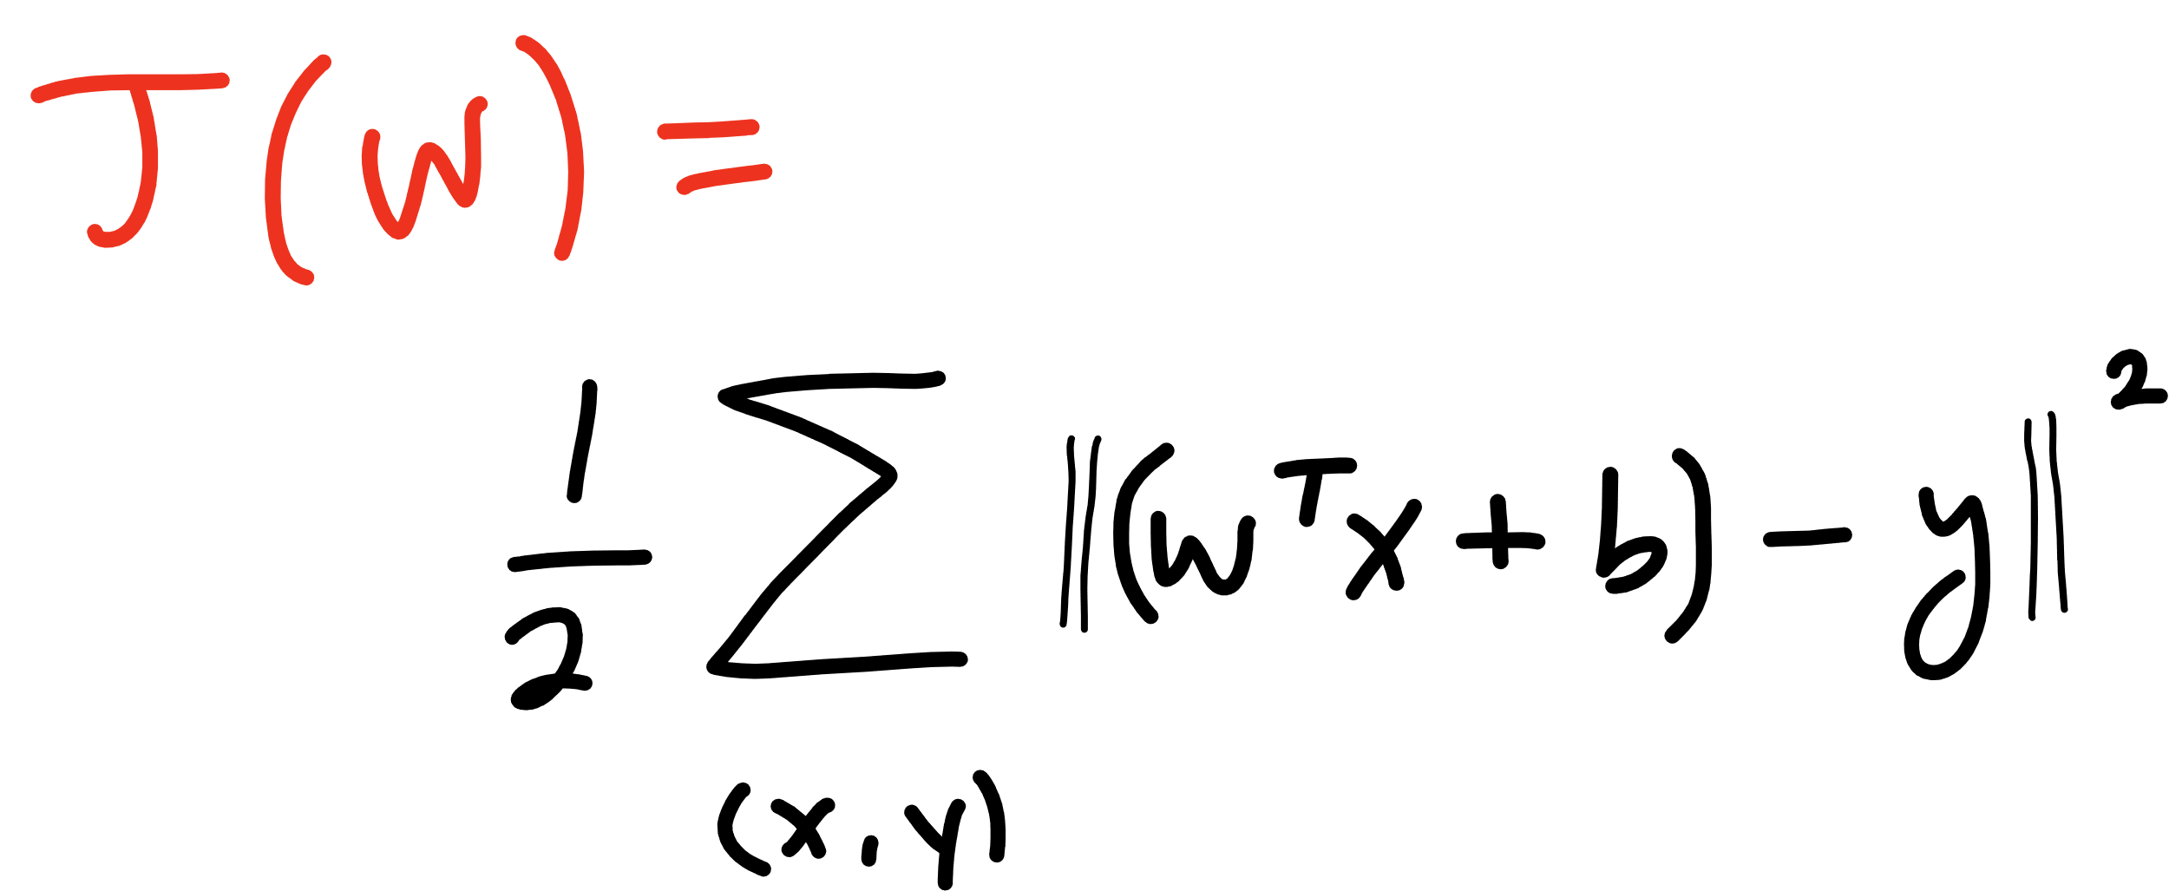

Slide 32
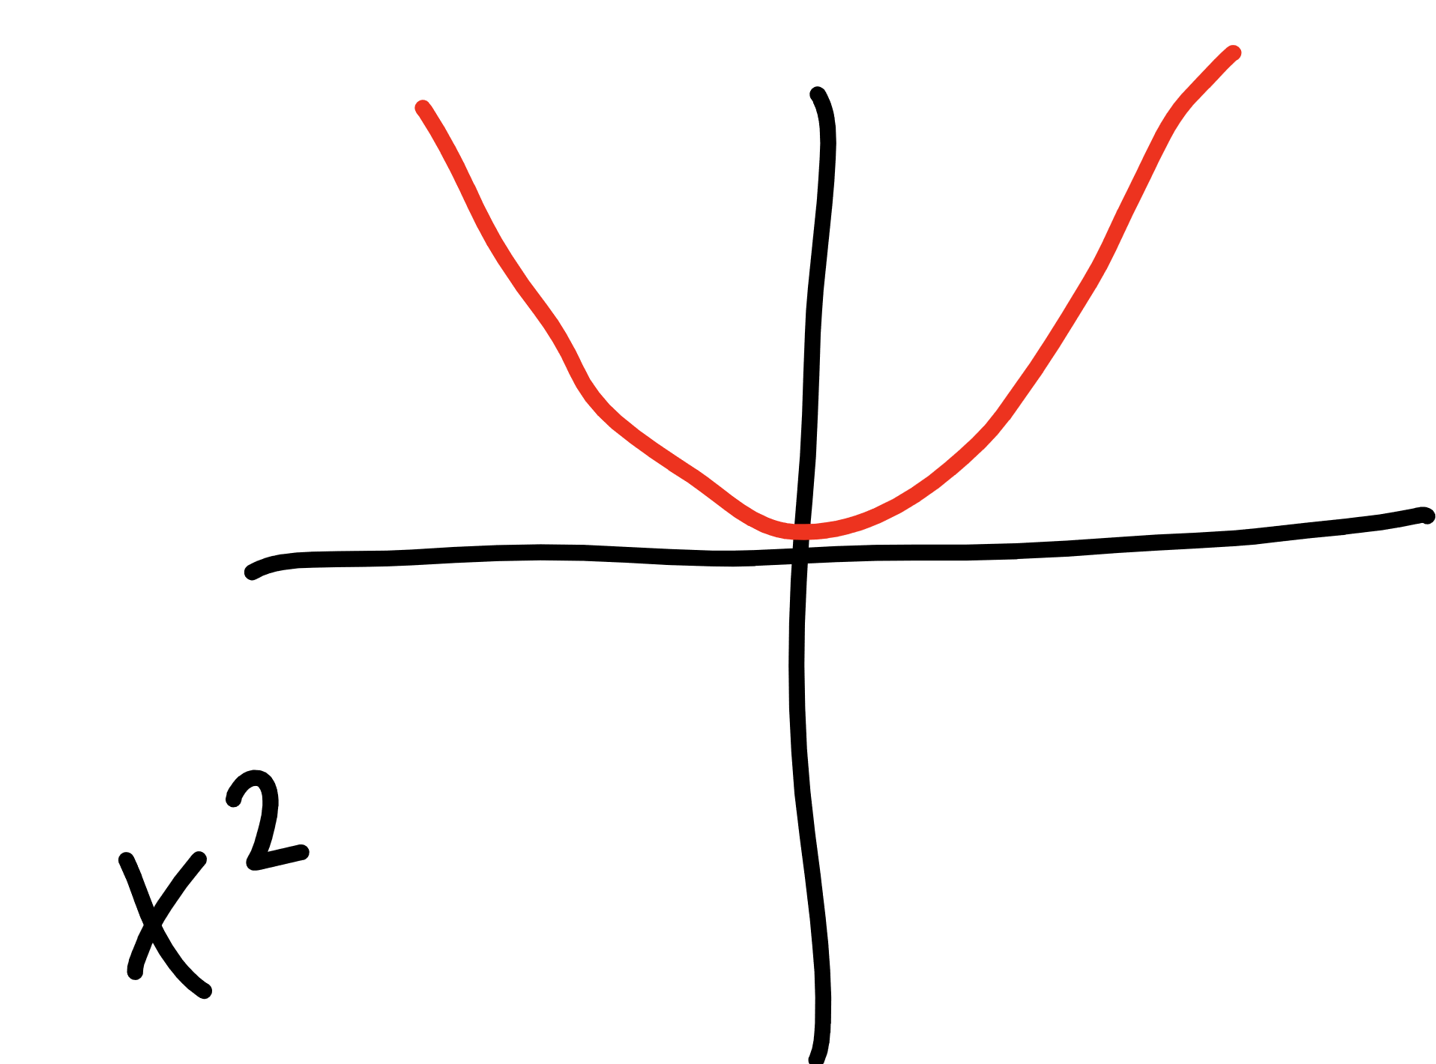

Slide 33
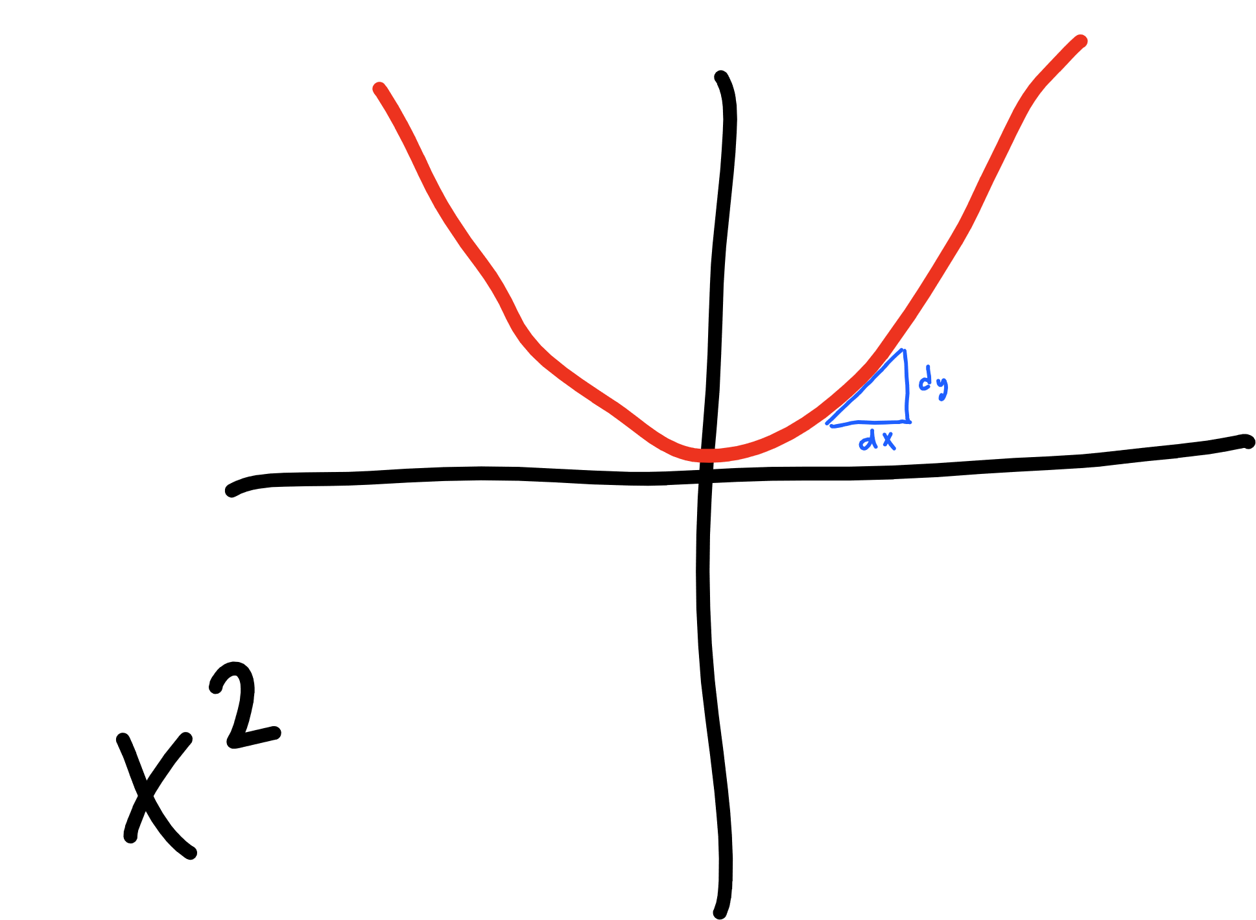

Slide 34
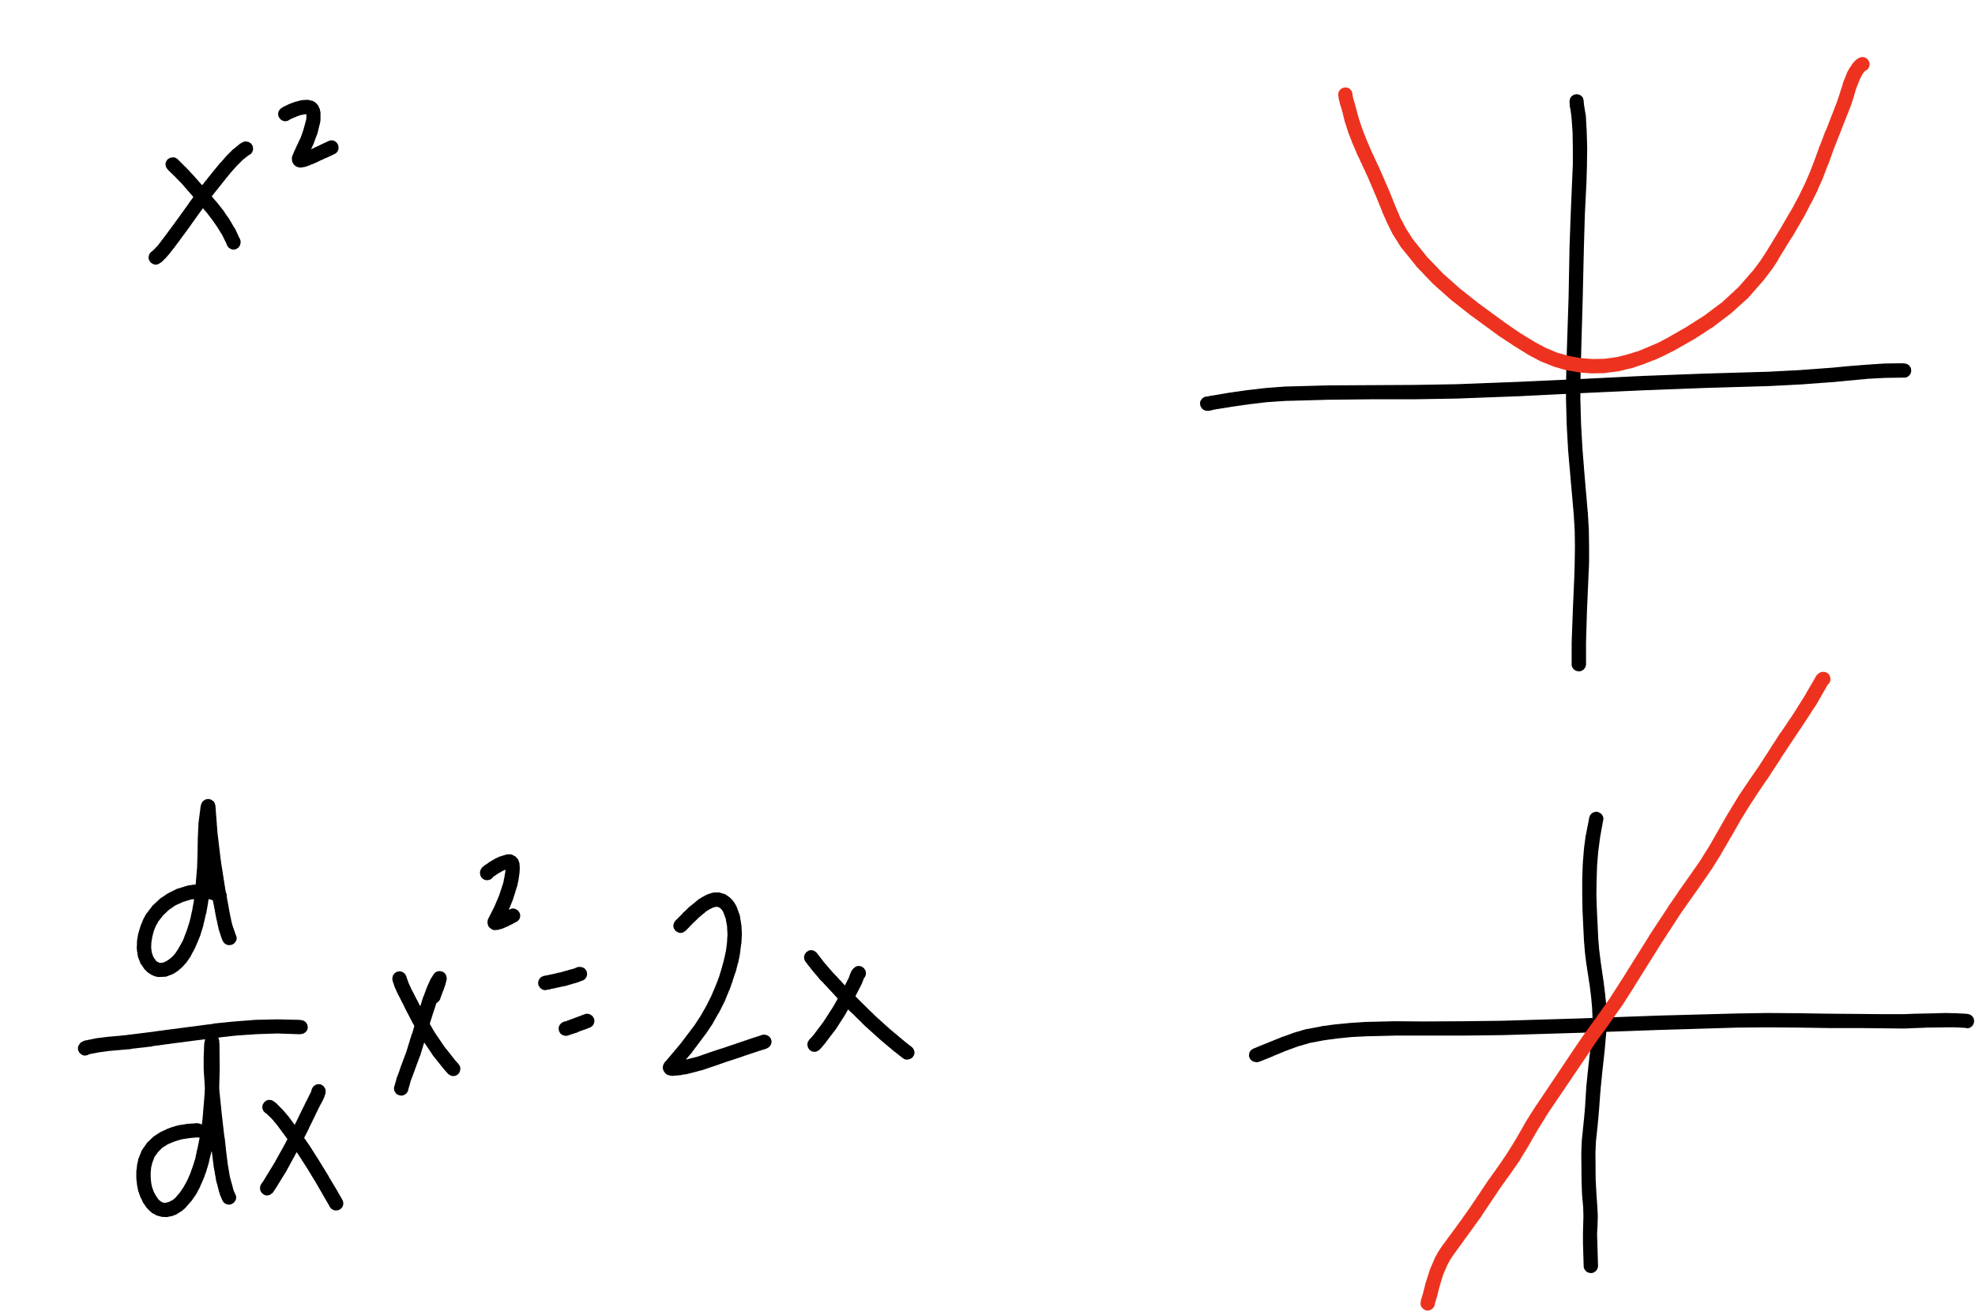

Slide 35
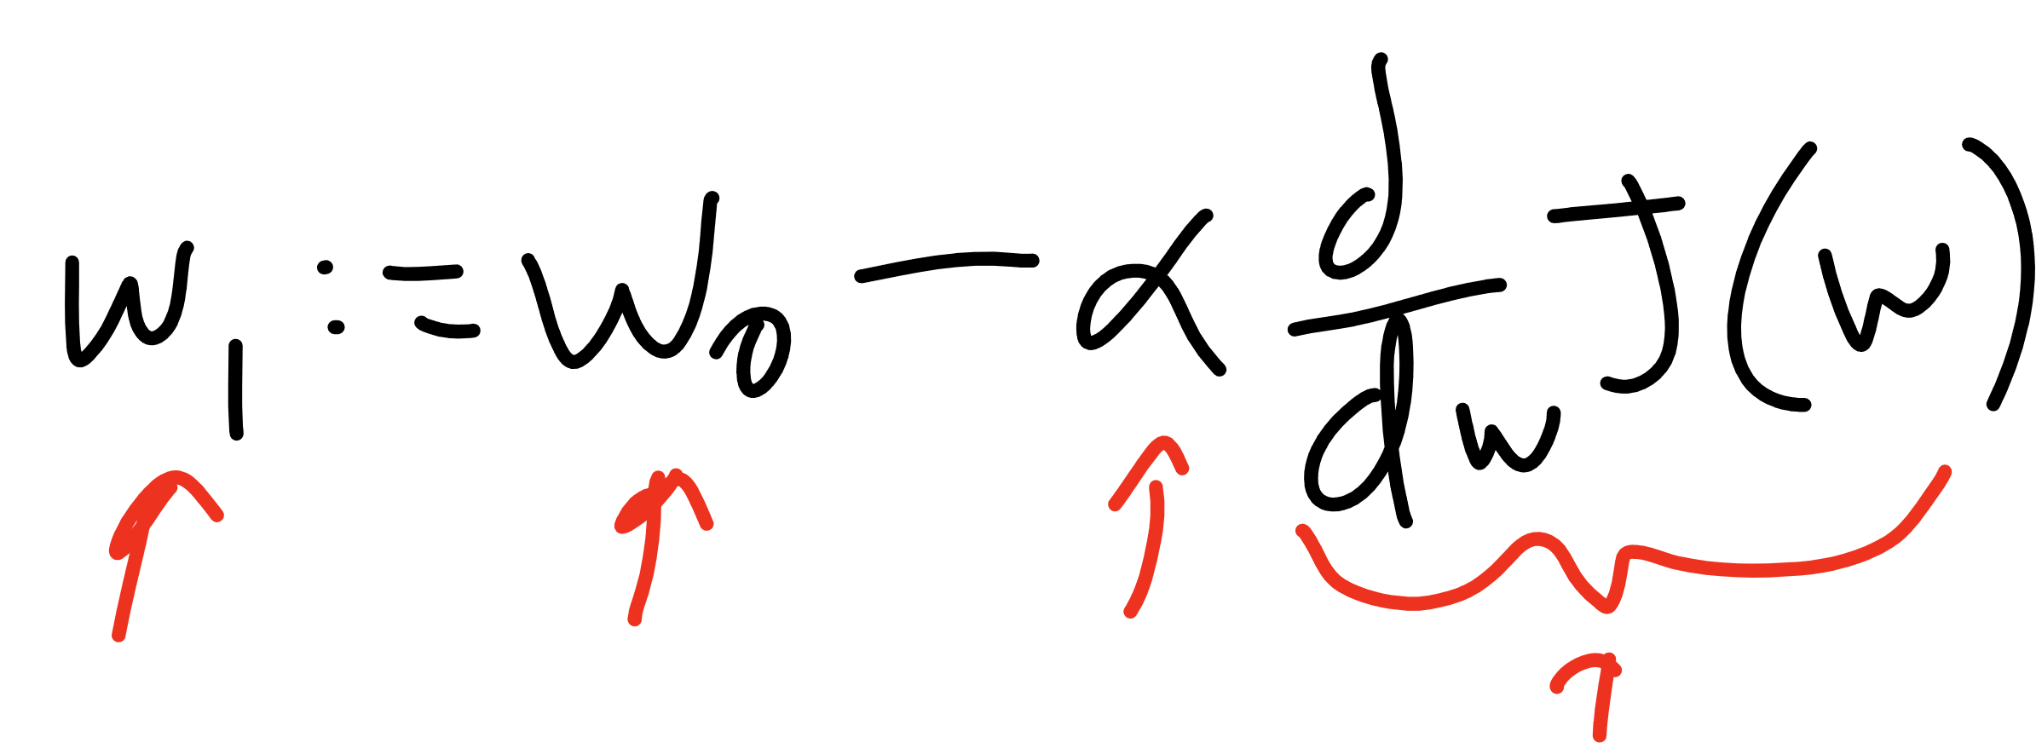
Current W
Learning Rate
Updated W
Derivative of
Cost Function

Slide 36
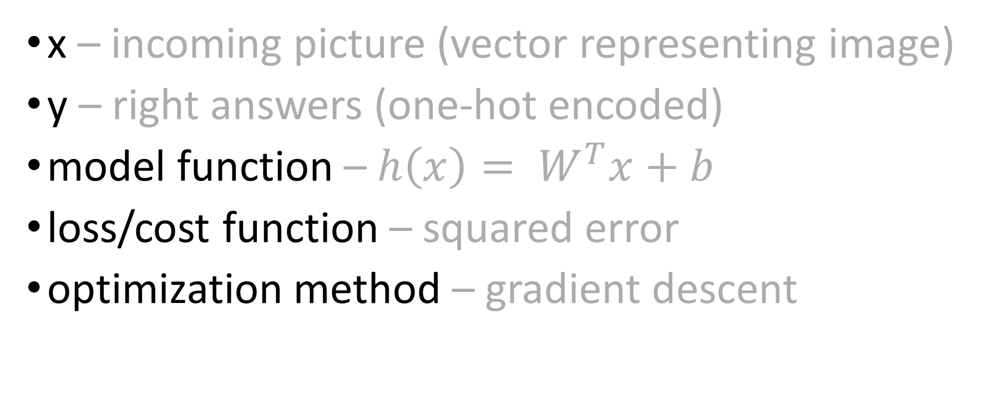
so far…
x – incoming picture (vector representing image)
y – right answers (one-hot encoded)
model function – $h\left(x\right)= W^{T}x+b$
loss/cost function – squared error
optimization method – gradient descent

Slide 37
TensorFlow
Step 1 – Define a Graph
Step 2 – Start a Session
Step 3 – Run!

Slide 38
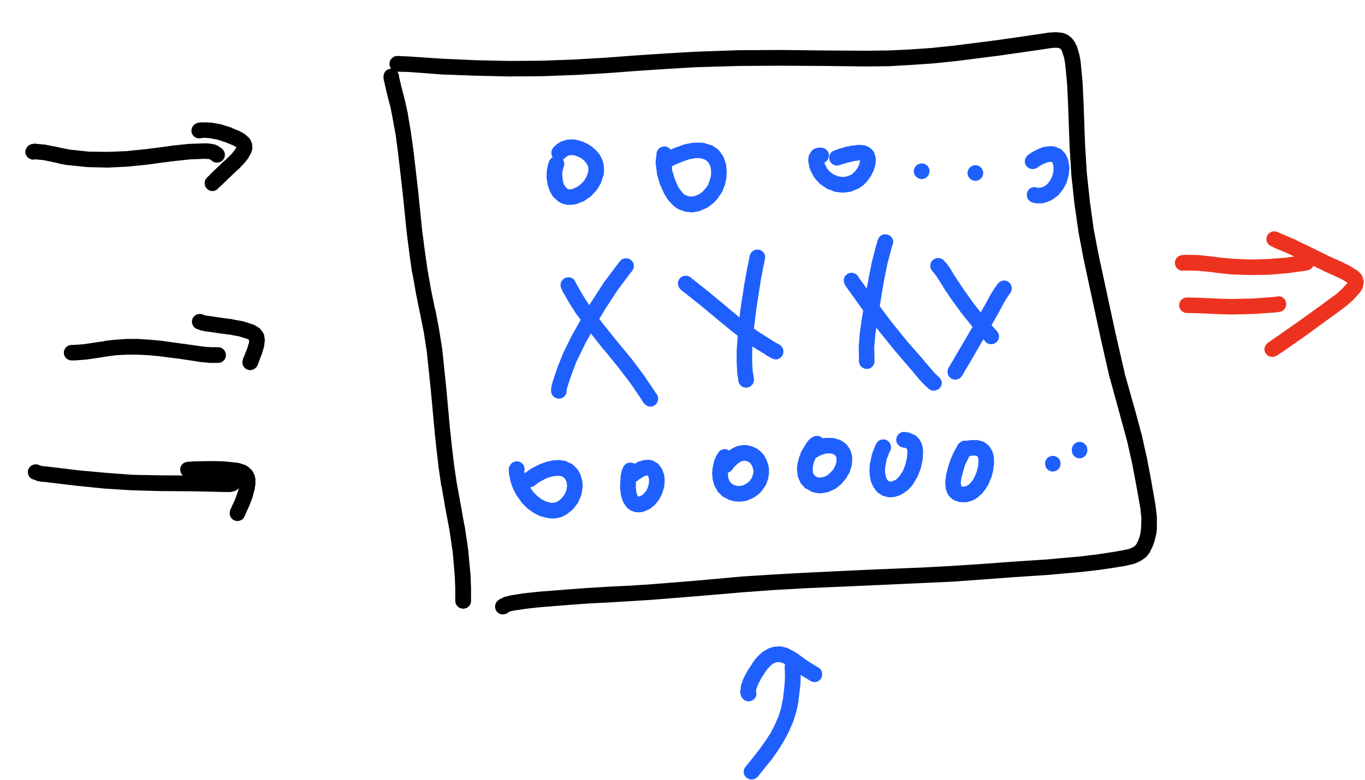
TensorFlow – Building the Graph
placeholders
graph
variables
constants
x, y, model, cost, accuracy, optimization…

Slide 39


Slide 40
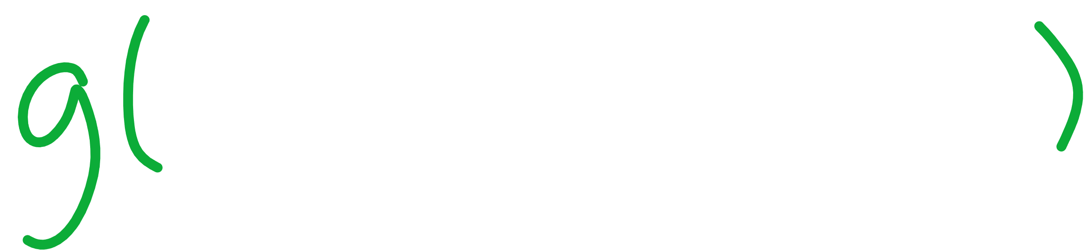

Slide 41
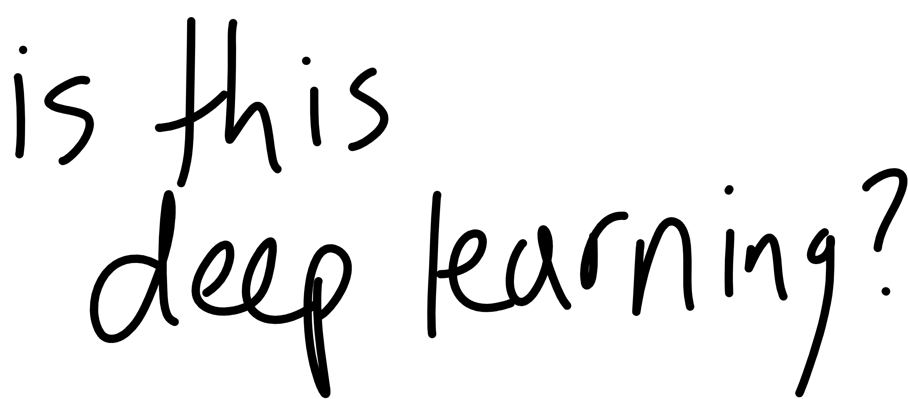

Slide 43
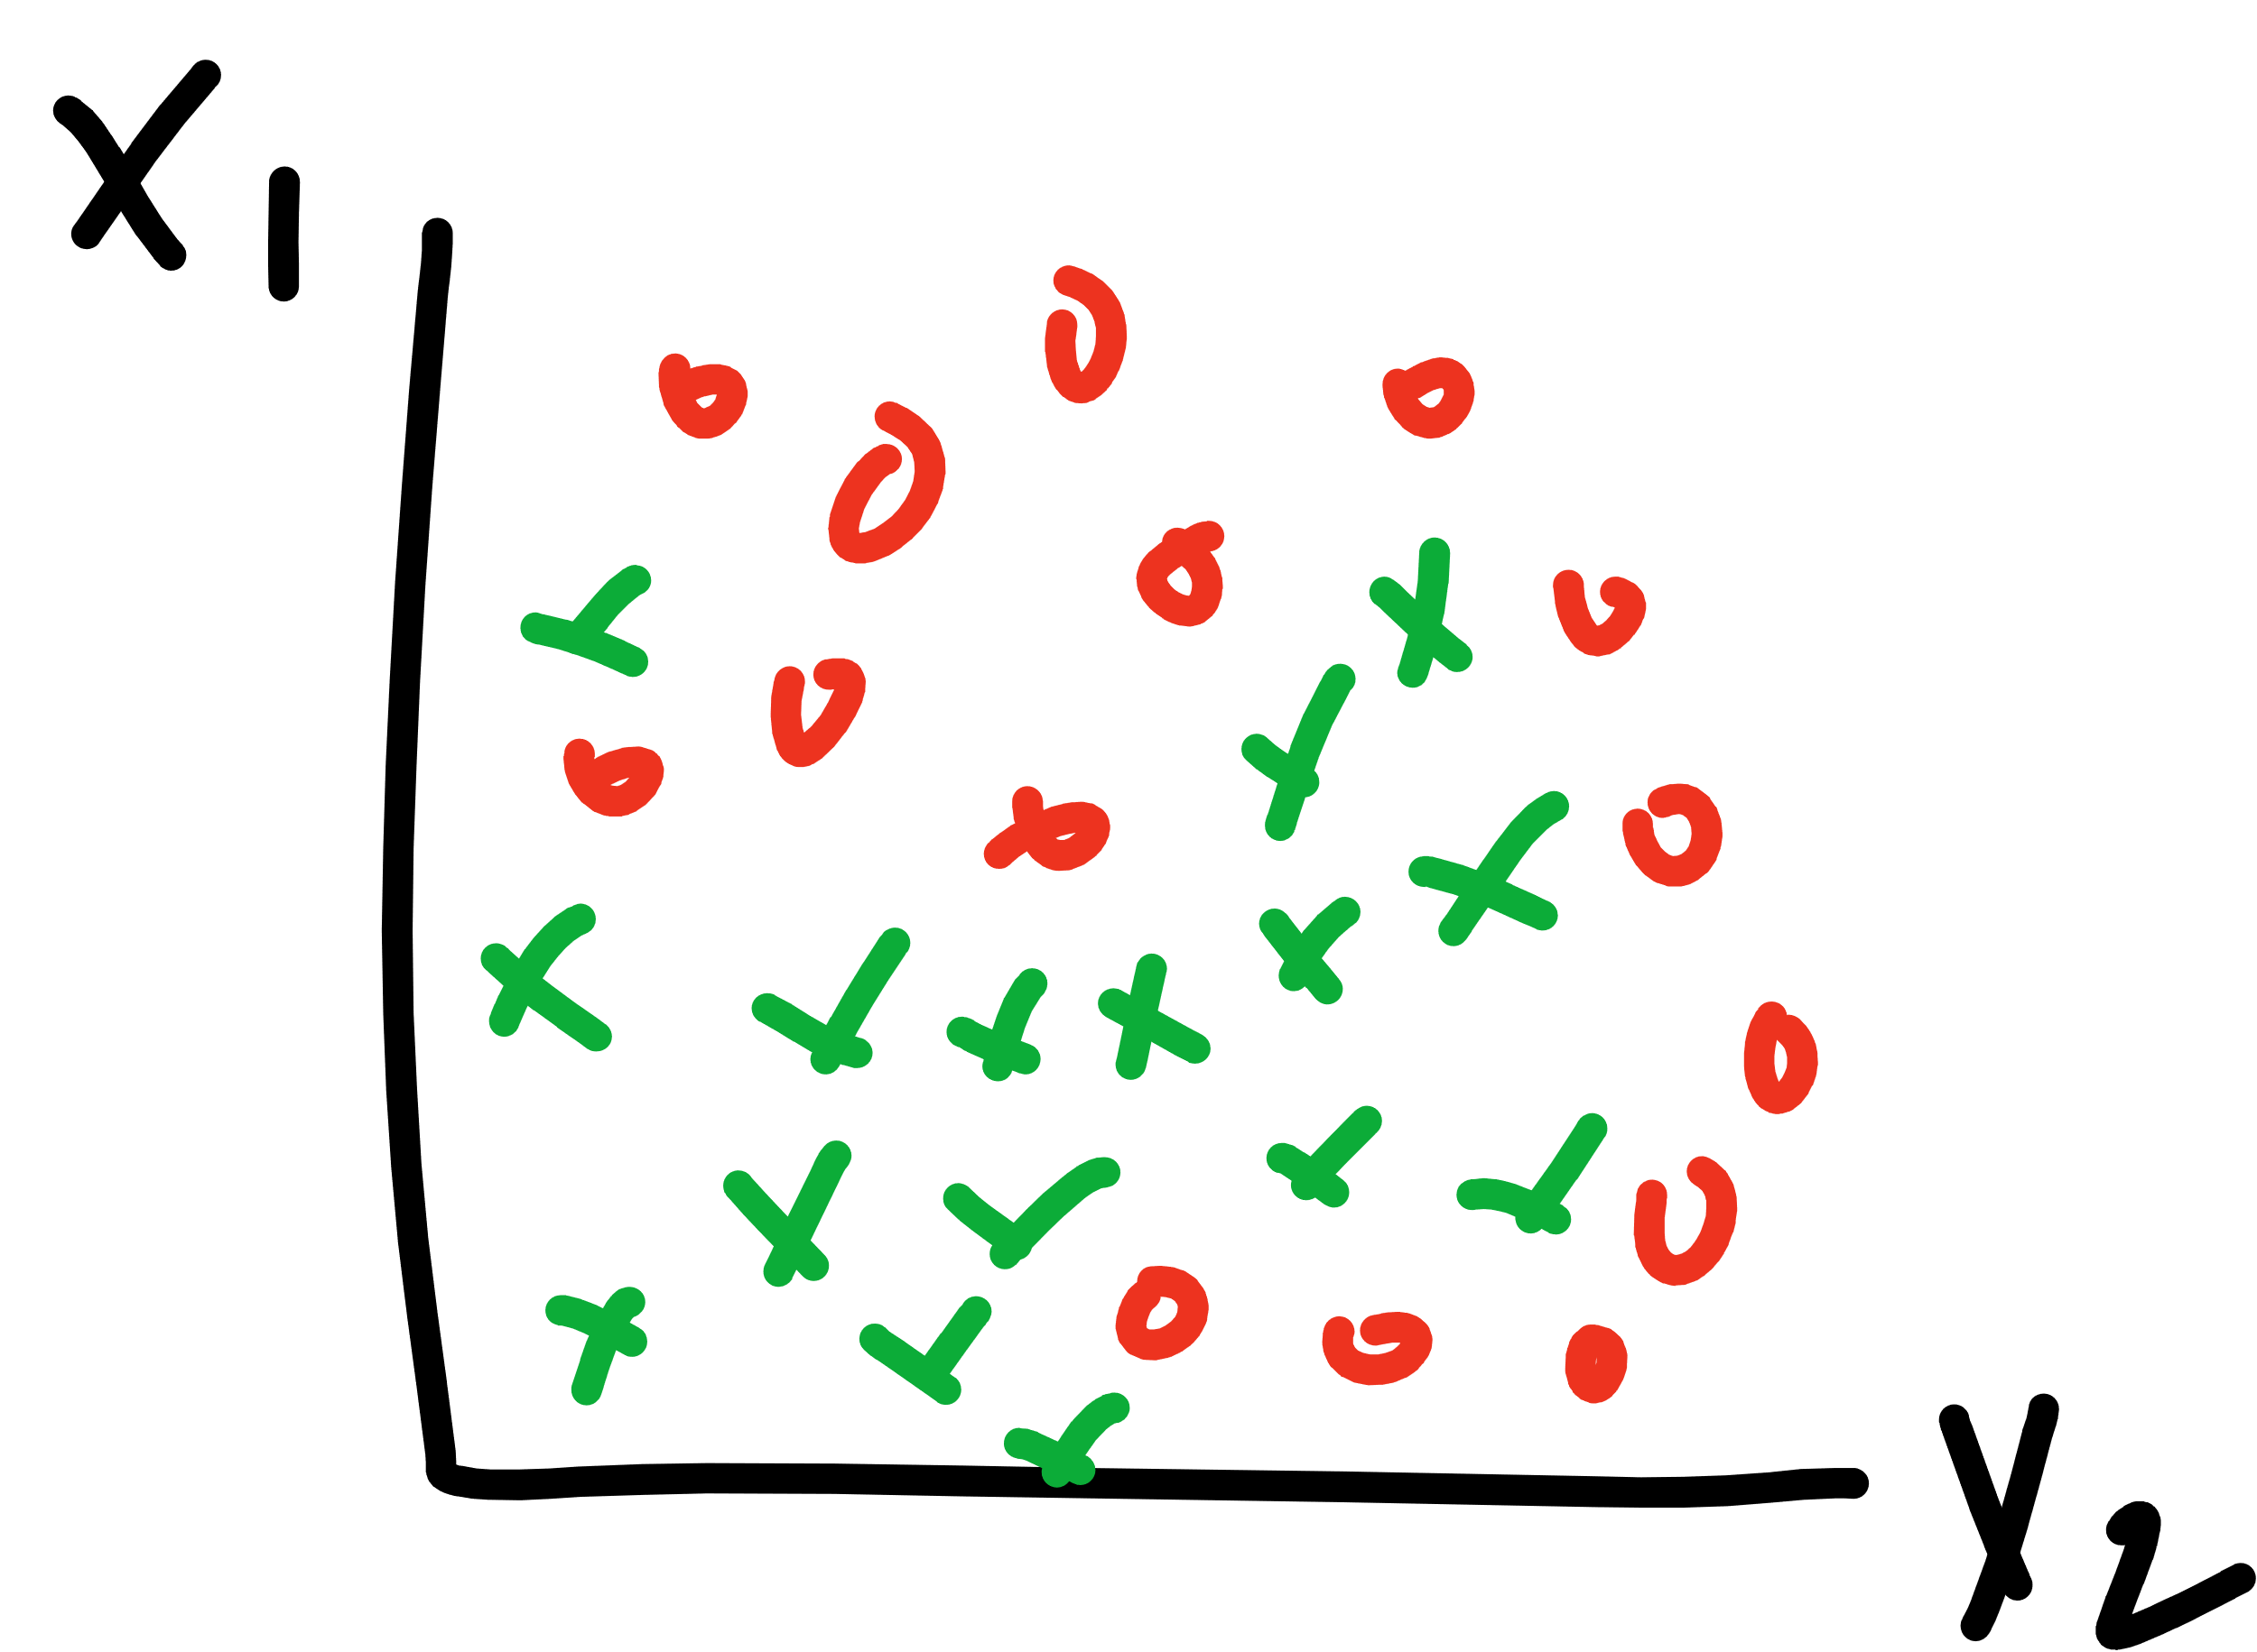

Slide 44
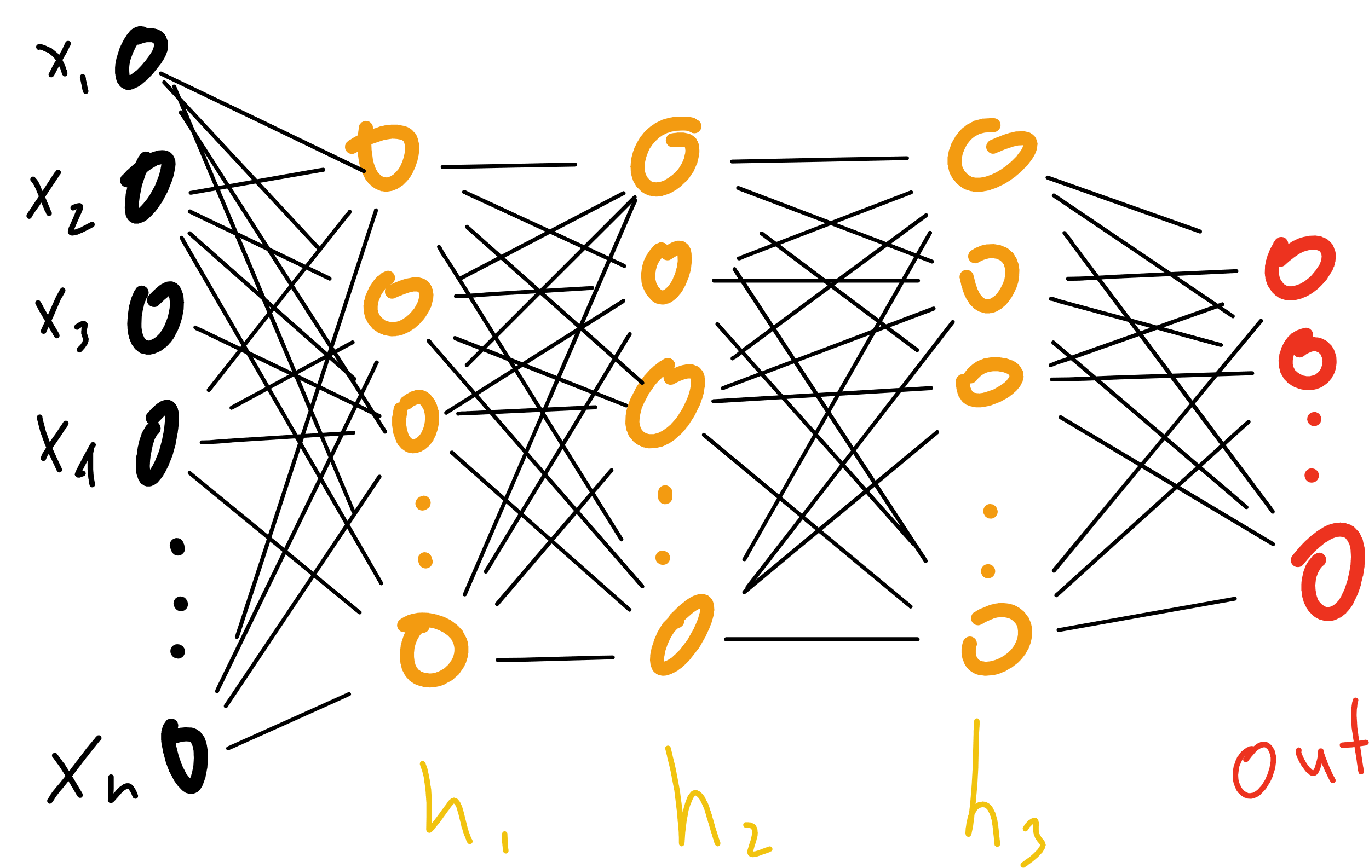

Slide 46
Notes:
Proof by induction

Slide 47
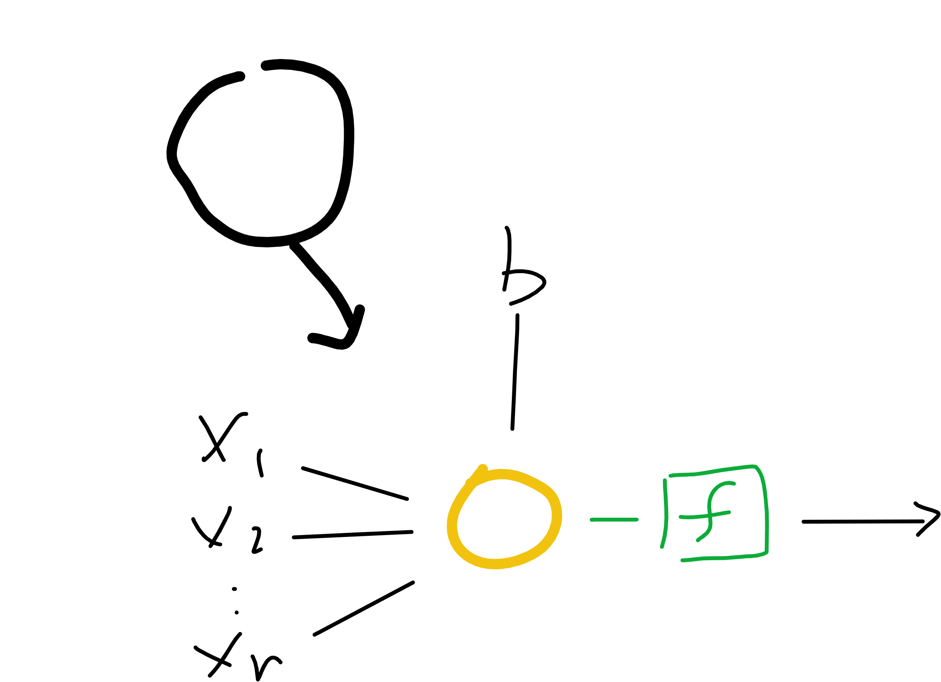
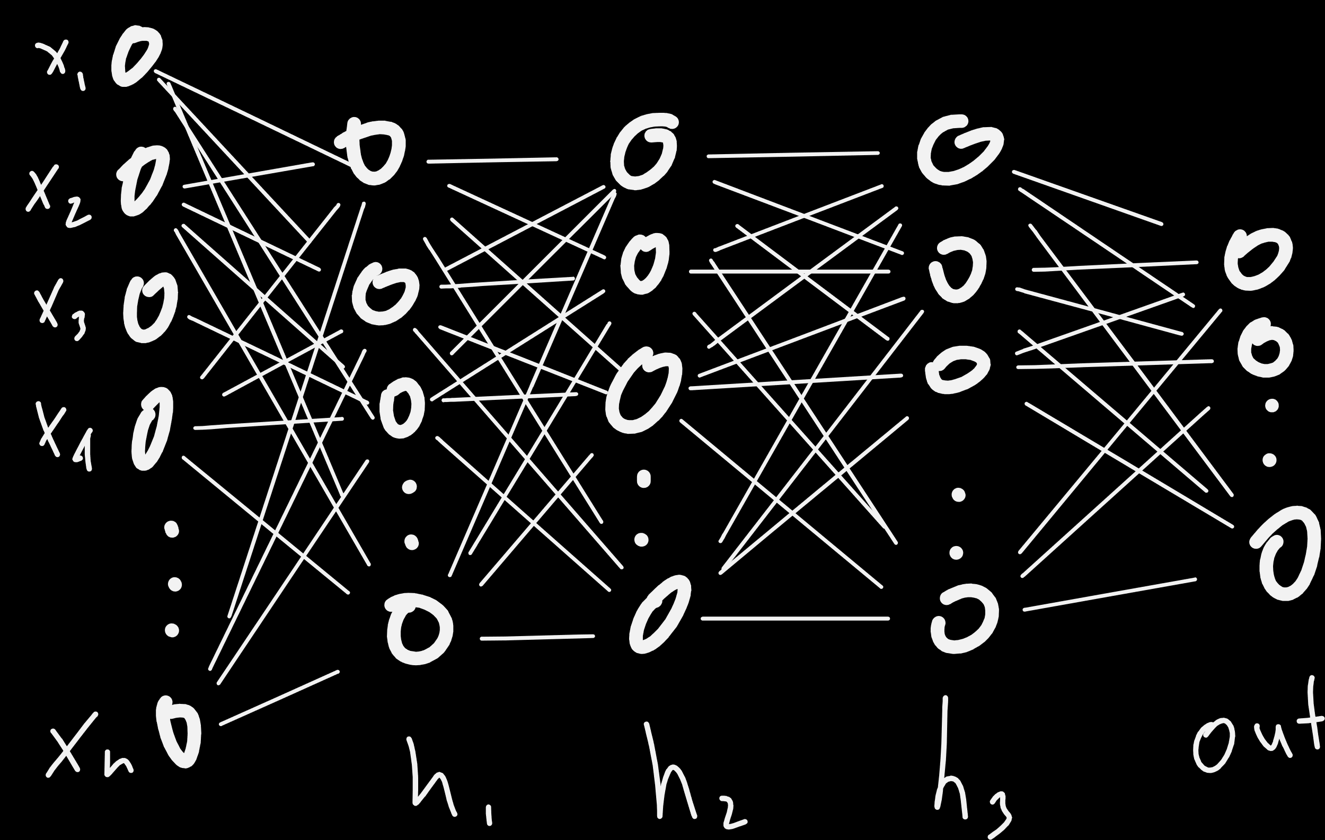
Notes:
Proof by induction

Slide 48
Notes:
Proof by induction

Slide 49
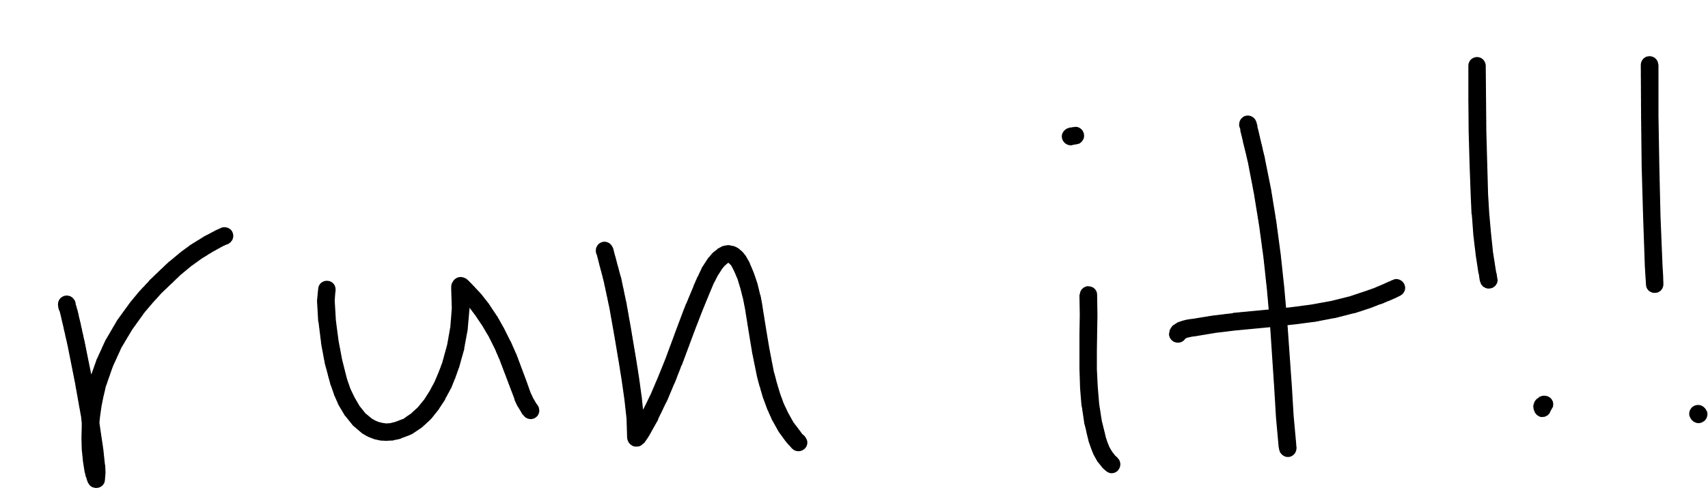

Slide 50
Notes:
Derivative?
Architecture

Slide 51
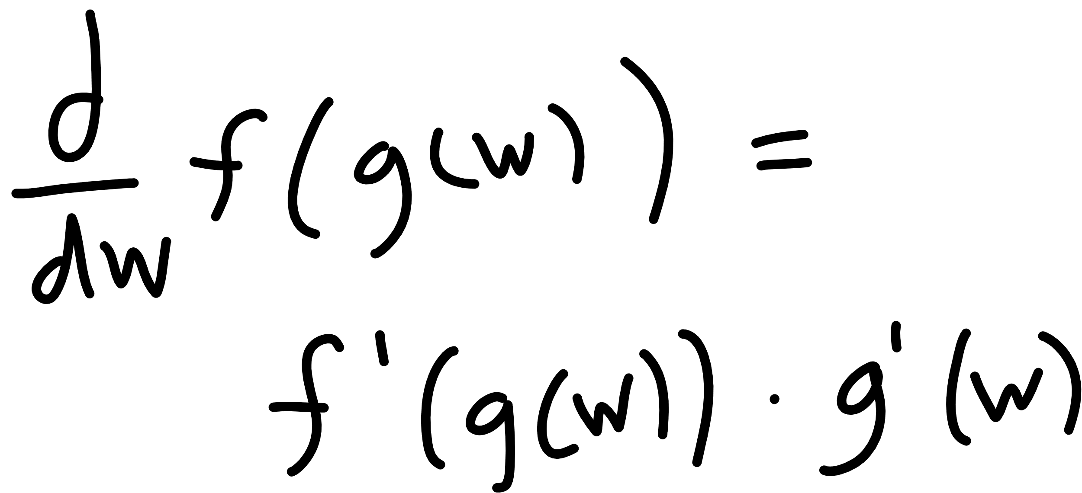

Slide 52
Notes:
Derivative?
Architecture

Slide 53

http://www.asimovinstitute.org/neural-network-zoo/

Slide 54
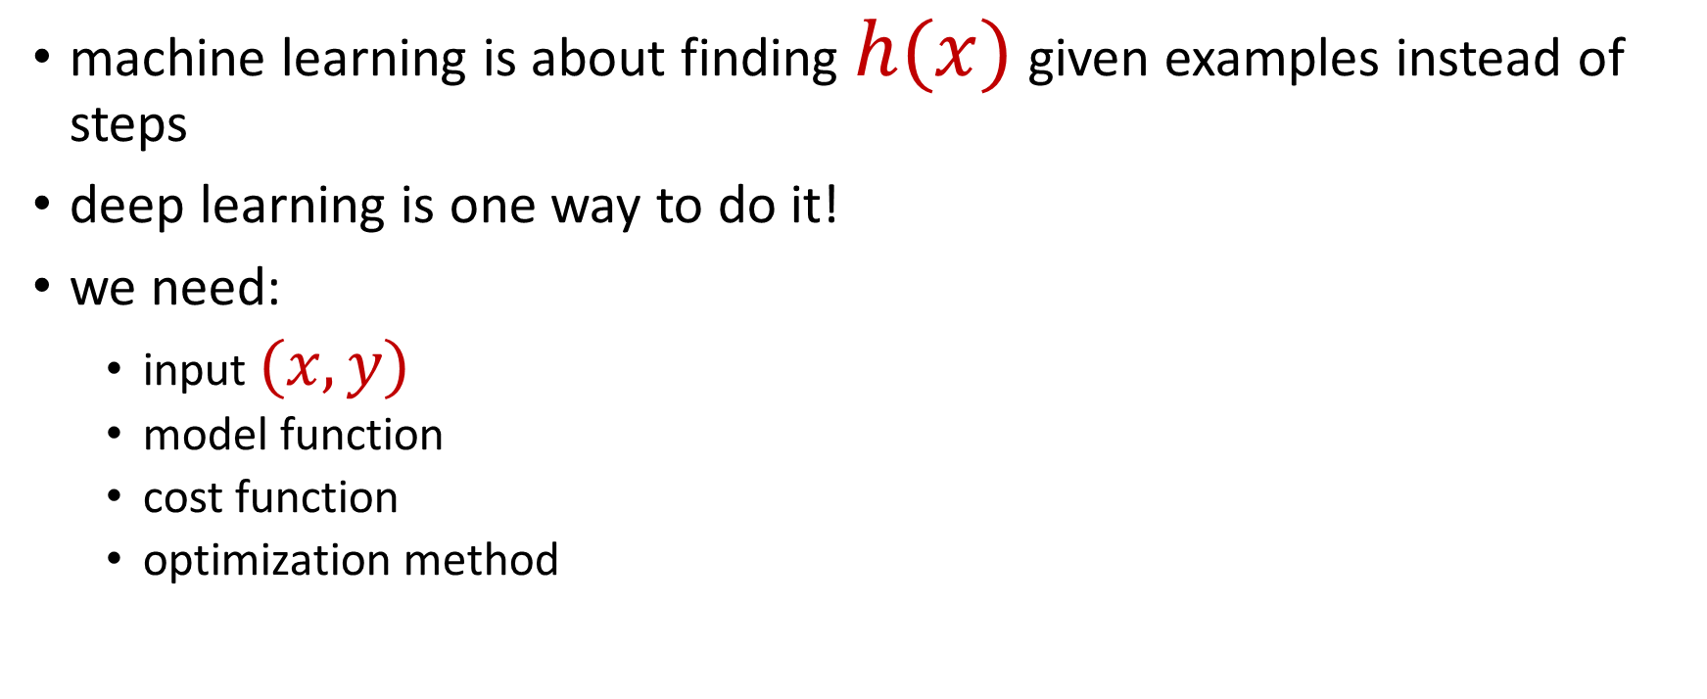
summary
machine learning is about finding $h(x)$ given examples instead of steps
deep learning is one way to do it!
we need:
input $(x, y)$
model function
cost function
optimization method

Slide 55
summary
TensorFlow is a framework that can help.
steps
define graph
start session
run training

Slide 56

Seth Juarez
Microsoft
@sethjuarez

